Slide 1


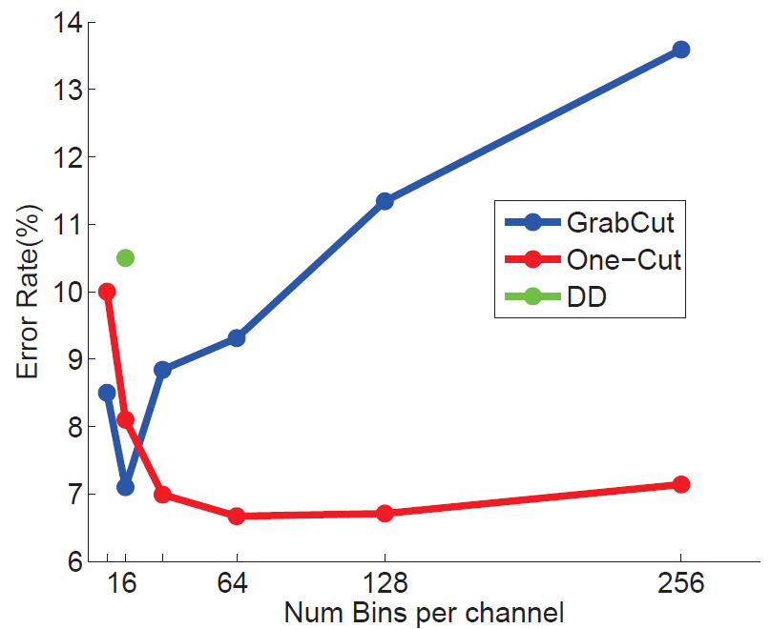
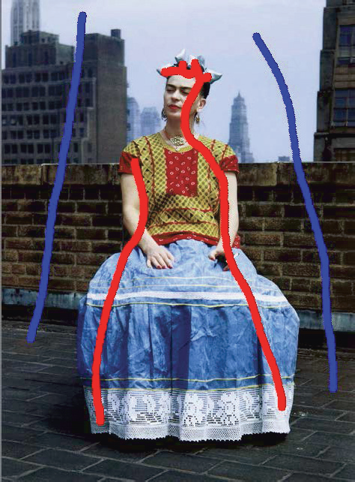

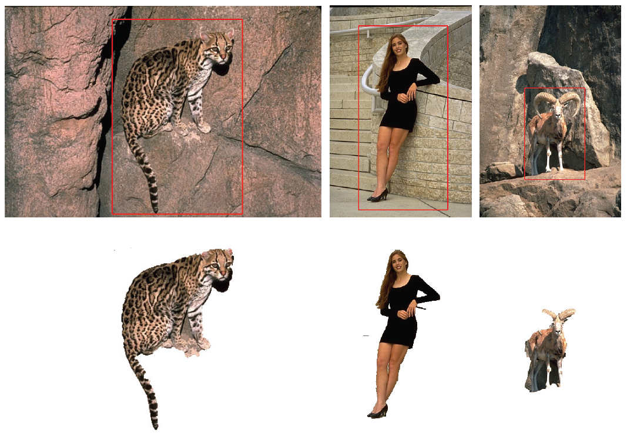

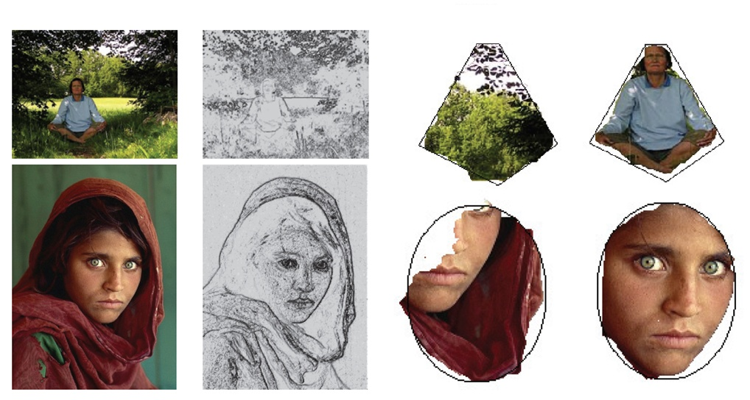
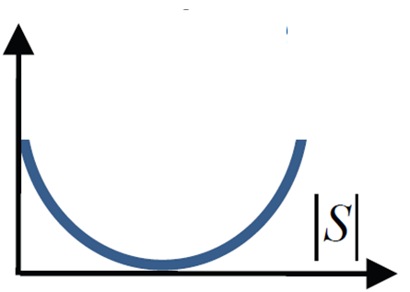
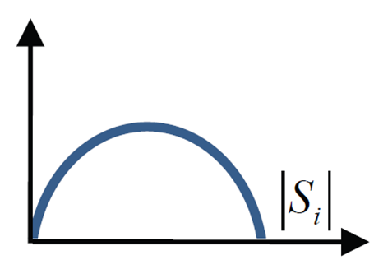
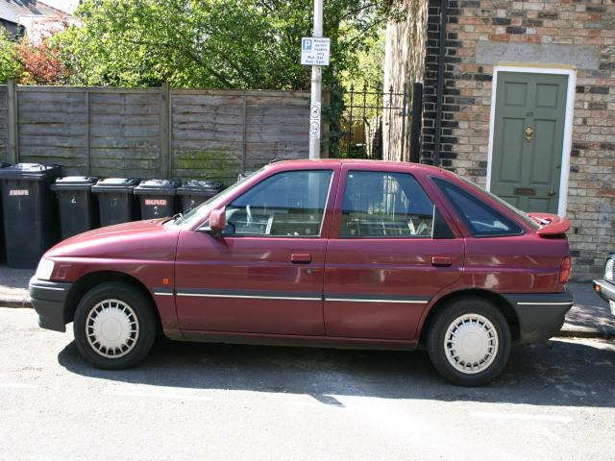
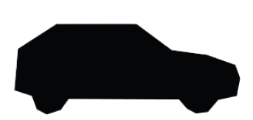
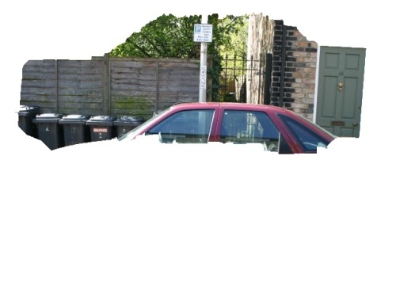
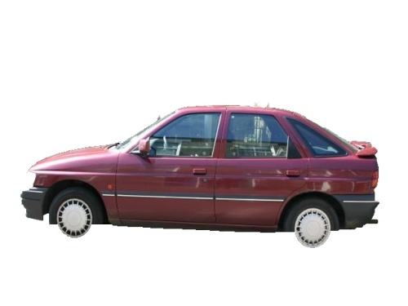
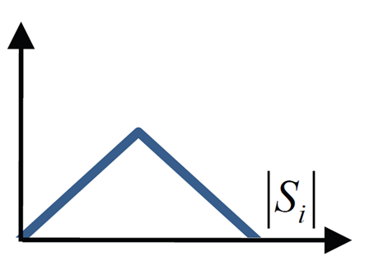
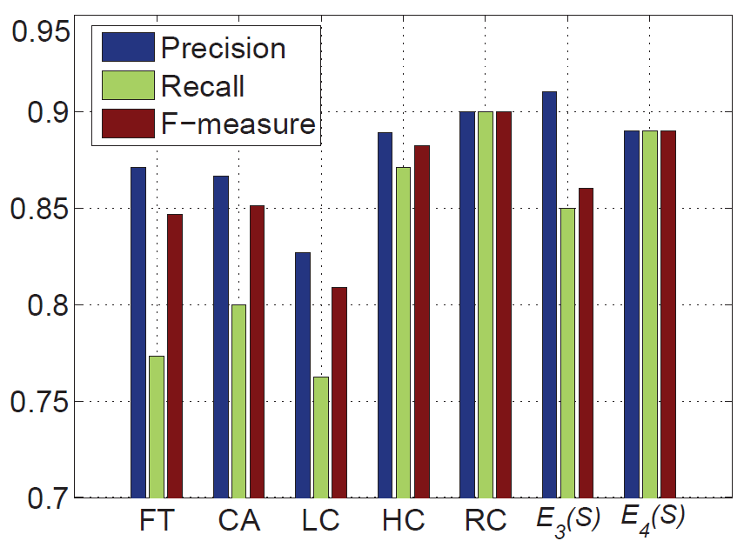
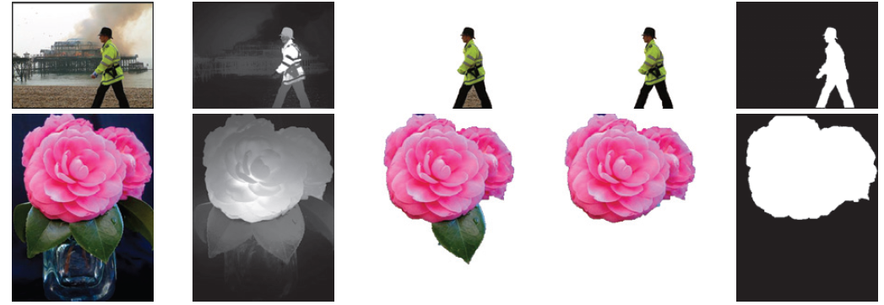
GrabCut in One Cut
Meng Tang Lena Gorelick Olga Veksler Yuri Boykov
http://vison.csd.uwo.ca
Basic Segmentation Energy
L₁ Color Separation Term
Application – Interactive Segmentation
Graph Cut [1] fixes appearances θ ⁰, θ ¹
L₁ penalty between color histograms of foreground and background:
With bounding boxes:
With strokes/seeds:
heuristic foreground ballooning
+
L₁ color separation
hard constrains + L₁ color separation
GrabCut [2] optimizes appearances θ ⁰, θ ¹
Bounding box
Our construction: add one auxiliary node a_{i} for each color bin i
Our interpretation via entropy:
a_{i}
simpler than construction in [4]
entropy of
colors in S
entropy of
colors in
high entropy example
low entropy example
S
S
Seeds
One Cut result
S
S
One Cut results
low entropy => color separation
Overview of graph structure
Application – Shape Matching and Saliency Segmentation
Decomposing energy [3]
Input
Template
No L₁
With L₁
Hamming distance between template and segment
+
L₁ color separation
Grab Cut
volume
balancing
Jensen-Shannon (JS)
color separation
 | TP | FP | Time
No L₁ | 76.97% | 6.96% | 4.1 s
With L₁ | 81.88% | 3.86% | 13.0 s
connect pixels of each color
to corresponding auxiliary nodes
nonsubmodular
submodular [4]
Main New Ideas
Contributions
Saliency-based unary terms + L₁ color separation
L₁ penalty for color appearance overlap between segments
Simpler construction wrt P^{n}-Potts [4] in a new context (color separation rather then superpixel consistency)
Proposing various practical unary terms instead of GC volume balancing
Input
Saliency
No L₁
With L₁
GT
L₁ color separation
To avoid trivial solution, replace with application dependent unary term
(ballooning, saliency, seeds, etc.)
Replace JS
with L₁
[1] Y. Boykov and M. Jolly, Interactive Graph Cuts for Optimal Boundary &
Region Segmentation of Objects in N-D Images, ICCV 2001.
[2] C. Rother, V. Kolmogorov and A. Blake, GrabCut: Interactive Foreground
Extraction using Iterated Graph Cuts, SIGGRAPH 2004.
[3] S. Vicente, V. Kolmogorov and C. Rother, Joint Optimization
of Segmentation and Appearance Models, ICCV 2009.
[4] P. Kohli, L. Ladicky, and P. H. S. Torr. Robust Higher Order Potentials
for Enforcing Label Consistency. IJCV, 2009.

