Slide 1


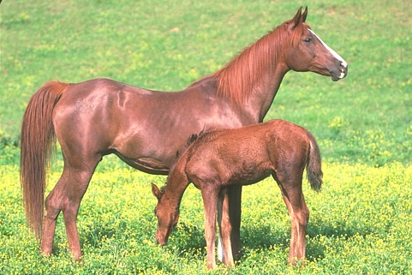

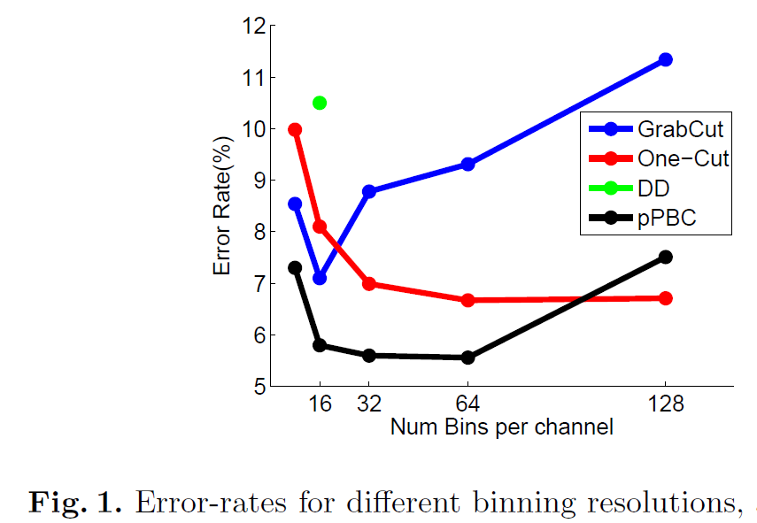
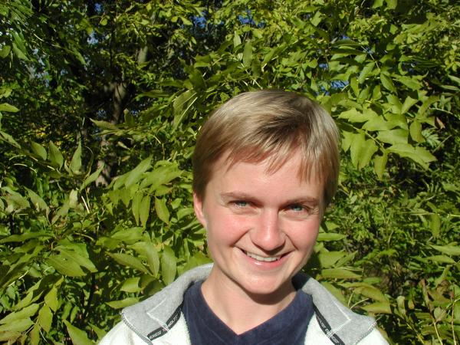

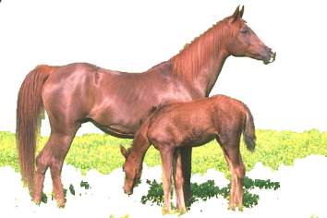
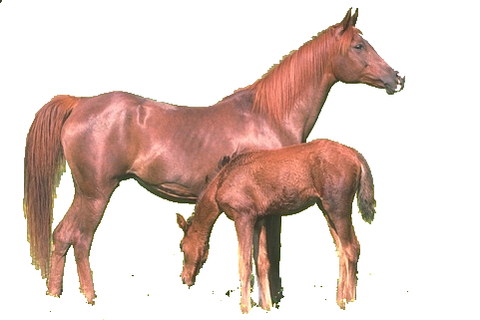



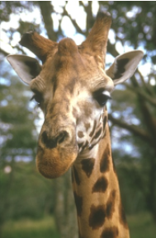

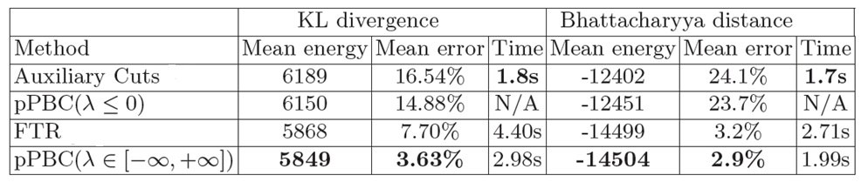
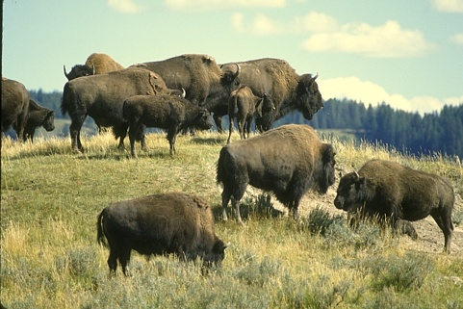

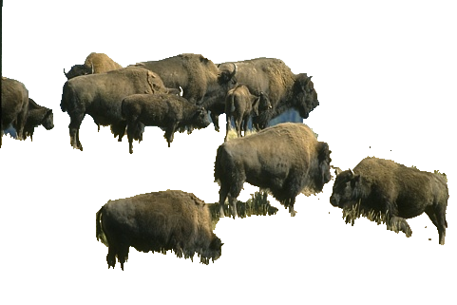
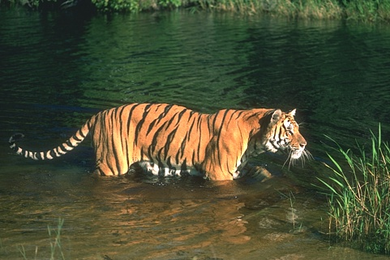

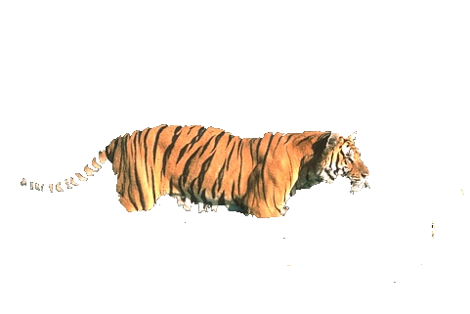
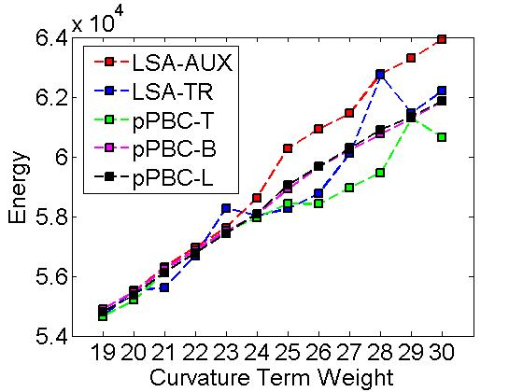
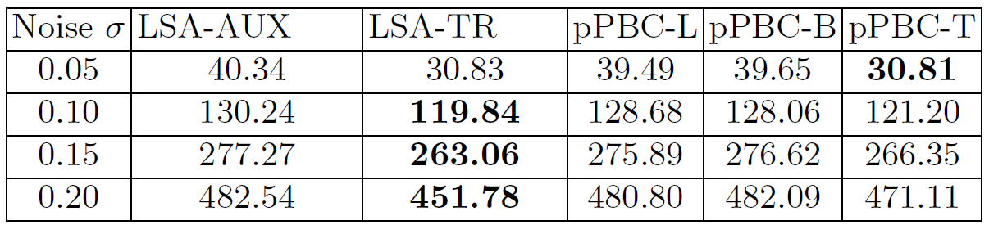
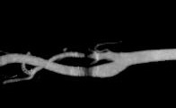
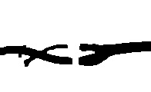
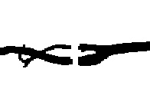
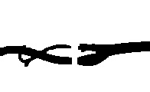








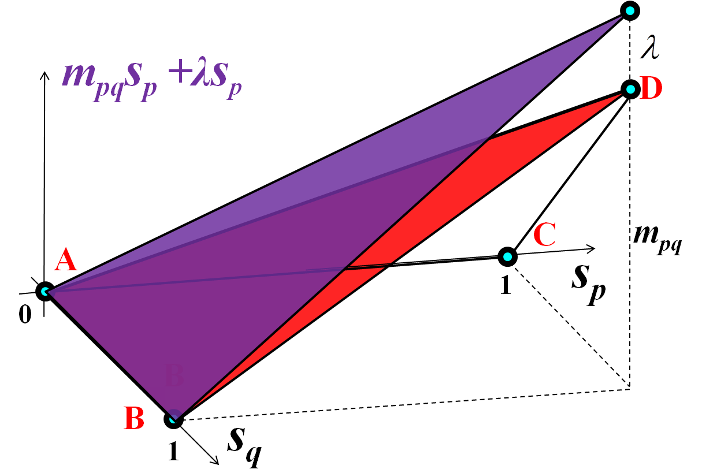
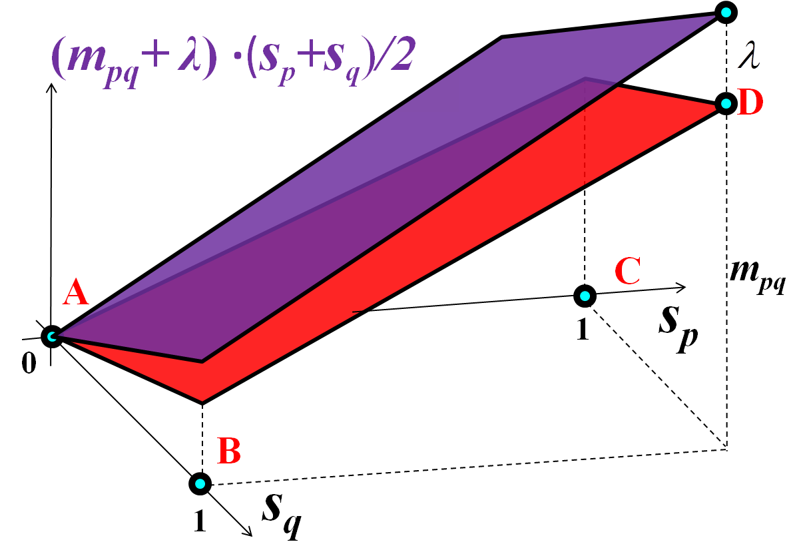
Pseudo-Bound Optimization for Binary Energies
Meng Tang¹ Ismail Ben Ayed² Yuri Boykov¹
¹University of Western Ontario, Canada ²GE Healthcare Canada
Binary Energy Minimization
From Model-fitting to Entropy Minimization
Application --- High-order Energy
S* = arg_{S} min E(S)
mixed optimization
1
Interactive Segmentation
Unsupervised Segmentation
Initializations
2
Input images
Results
Binary Energy:
cross-entropy
entropy
Difficult-to-optimize energies:
binary optimization
Note: H(P|Q) ≥ H(P) for any two distributions (equality when Q=P)
Non-submodular pairwise energy
High-order energy
high-order
BCD
BCD (block-coordinate-descent) of
E=1.4198×10⁶
E=1.4026×10⁶
Standard Bound Optimization
pPBC
Minimize over segmentation S for fixed θ₀ , θ₁ [1]
E=1.4026×10⁶
E=1.4026×10⁶
E(S)
A_{t}(S)
Minimize over θ₀ , θ₁ for fixed labeling S
Matching Target Distribution
Input image
Ground truth
Results
^{t t}
E(S_{t})
E(S|θ₀ ,θ₁ )
^{t+1 t+1}
E(S_{t+1})
(I)
E(S|θ₀ ,θ₁ )
E(S)
(II)
solution space
Comparison of Auxiliary Cuts, FTR, pPBC and its limited version (λ ≤ 0).
S_{t}
S_{t+1}
S
^{t t}
S_{t}
S_{t+1}
is a bound of original energy E(S).
Never increases original energy E(S)
Converges to local minima
Bound may not approximate well
E(S|θ₀ ,θ₁ ) =
Application --- Non-submodular Pairwise
BCD, as is in GrabCut [2], is bound Optimization for E(S).
Segmentation with Curvature Regularization
Binary Image Deconvolution
New Idea: Pseudo-Bound Opt.
Parametric Pseudo-Bound Cuts (pPBC)
Average energy with 10 random noisy images.
Bound
Bounding relaxation
Edge capacities depend linearly on λ.
Input
LSA-AUX [4] t=0.1s
Ƒ_{t}(S , λ) = + λ R_{t}(S)
t
a cut
E(S)
A_{t}(S)
A_{t}(S)
t-link
n-links
E(S_{t})
Pairwise Submodular
Unary
t-link
LSA-TR [4] t=1.9s
pPBC-T t=3.1s
noisy image LSA-AUX [4] LSA-TR [4] pPBC-T
s
iterate
Top (bottom) row: nose sigma = 0.1 (0.2)
S^{λ} = min_{s} Ƒ_{t}(S , λ)
Parametric Maxflow [3]
Conclusion and Future Work
S_{t+1} = argmin E(S^{λ})
Update
solution space
S^{λ}
S_{t}
S_{t+1}
S_{t+1}
S
examples of pseudo-bounds
Novel generalization of majorize-minimize principle
Efficient opt. of pseudo-bounds via parametric max-flow
Showed that BCD (in GrabCut ) is a bound Optimization
Devise specific pseudo-bounds for several energies
Achieve state-of-the-art results for many binary energies
Future work: thorough comparison, multi-label energies
Make larger move S_{t} → S_{t+1}
Pseudo-bounds better approximate E(S)
Efficiently optimize pseudo-bounds
using parametric max-flow algorithm
For entropy-based energy:
For non-submodular pairwise:
Ƒ_{t}(S,λ)
=
^{t t}
E(S|θ₀ ,θ₁ )
+ λ(|S|-|S_{t}|)
m_{pq}s_{p}s_{q} , for m_{pq}>0
f(|S|)
Volume prior:
[1] Y. Boykov and M. Jolly, Interactive Graph Cuts for Optimal Boundary &
Region Segmentation of Objects in N-D Images, in ICCV 2001.
|V₀|
|S_{t}|
|S|
[2] C. Rother, V. Kolmogorov and A. Blake, GrabCut: Interactive Foreground
Extraction using Iterated Graph Cuts, in SIGGRAPH 2004.
[3] V. Kolmogorov, Y. Boykov, and C. Rother, Applications
of parametric maxflow in computer vision, in ICCV 2007.
[4] L. Gorelick, Y. Boykov, O. Veksler, I. Ayed and A. Delong,
Submodularization for Binary Pairwise Energies, in CVPR 2014.

