Slide 1





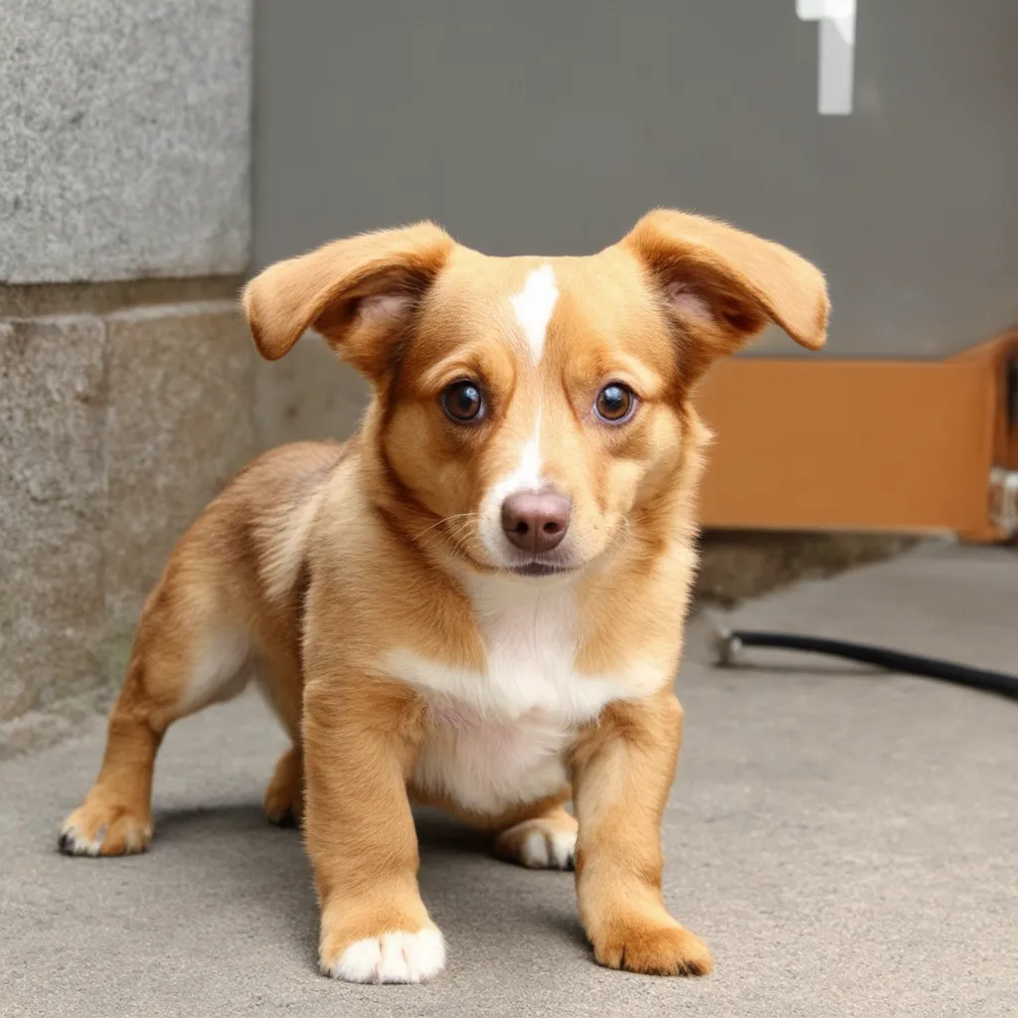
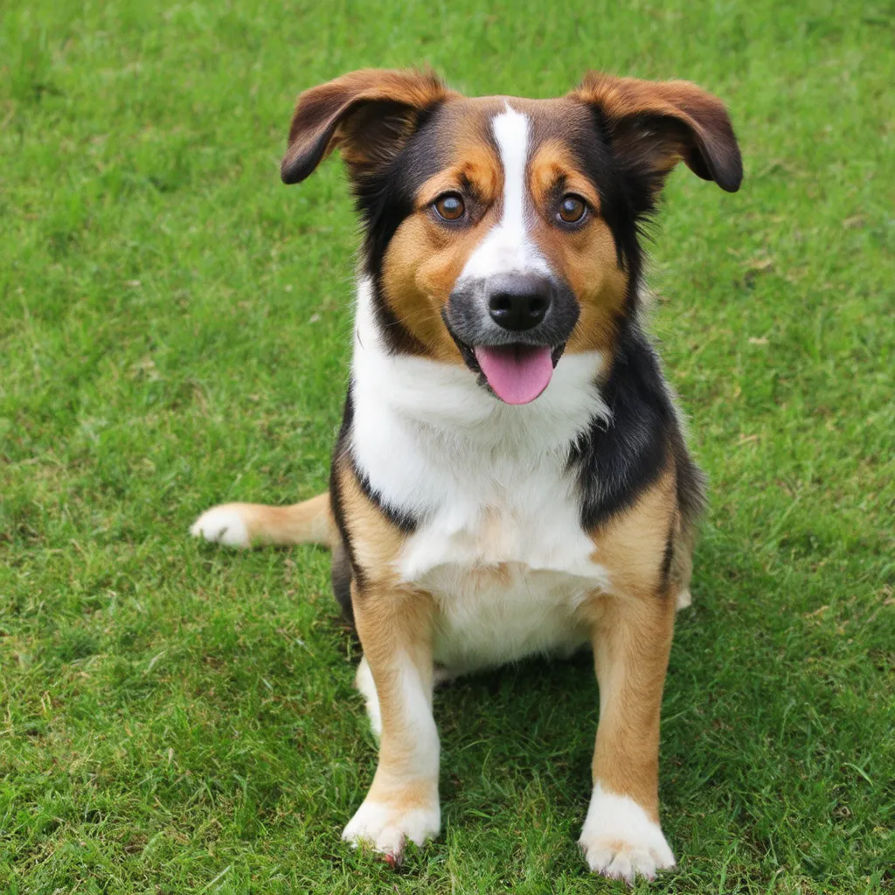
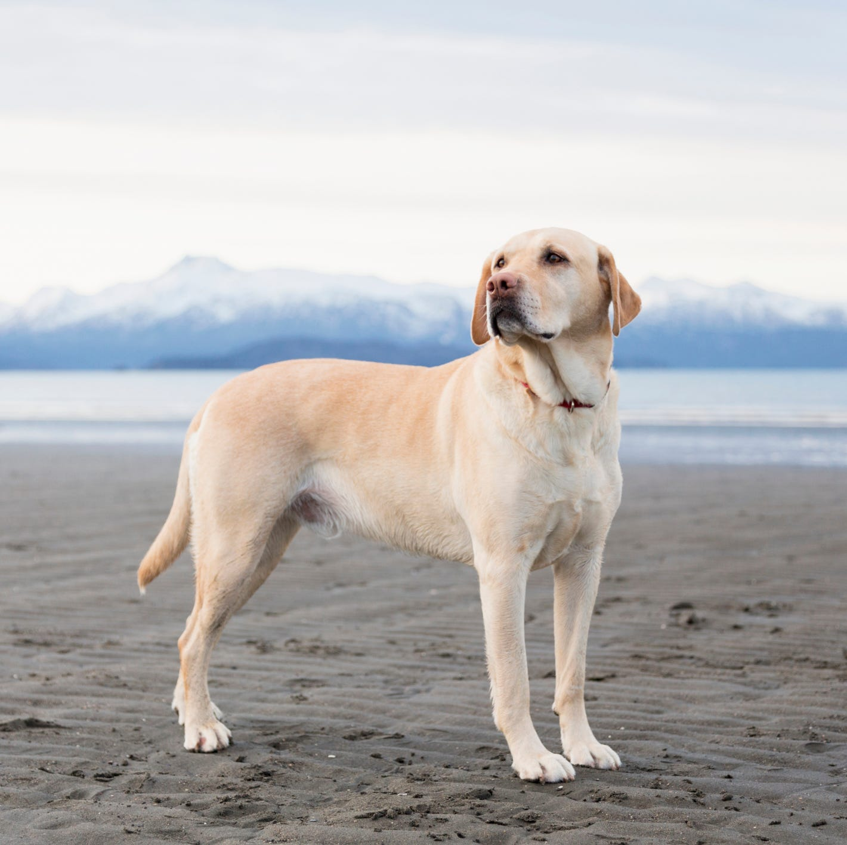
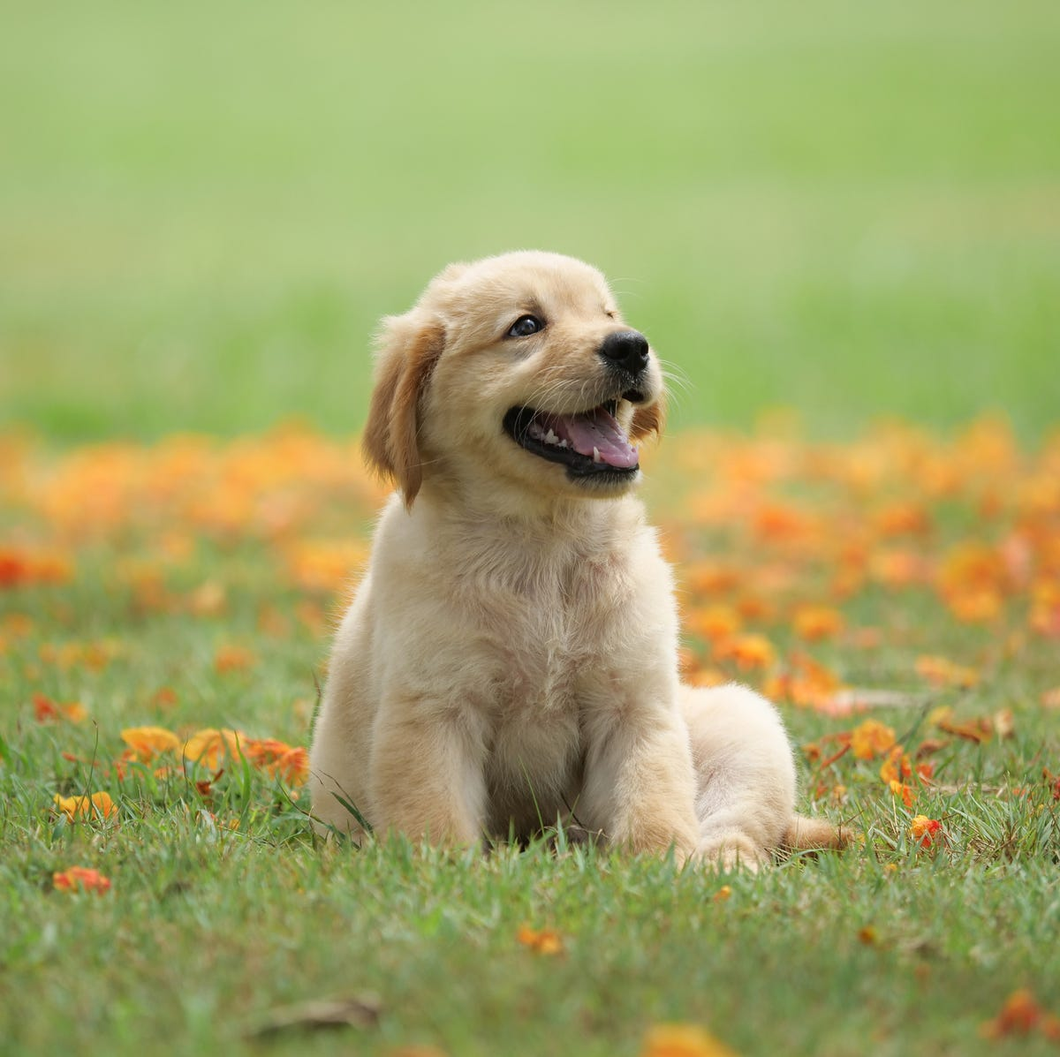
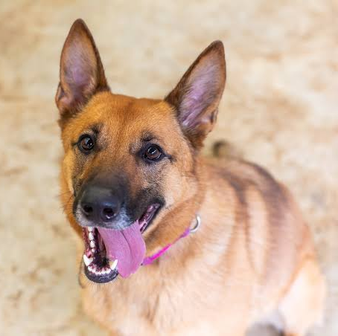

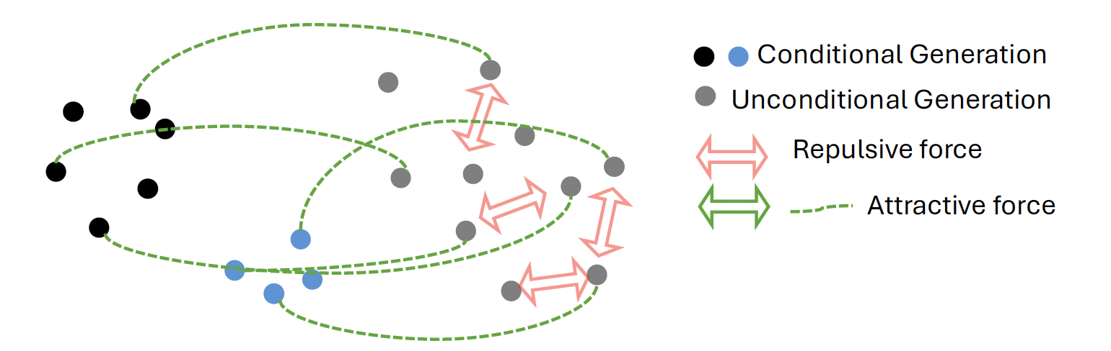
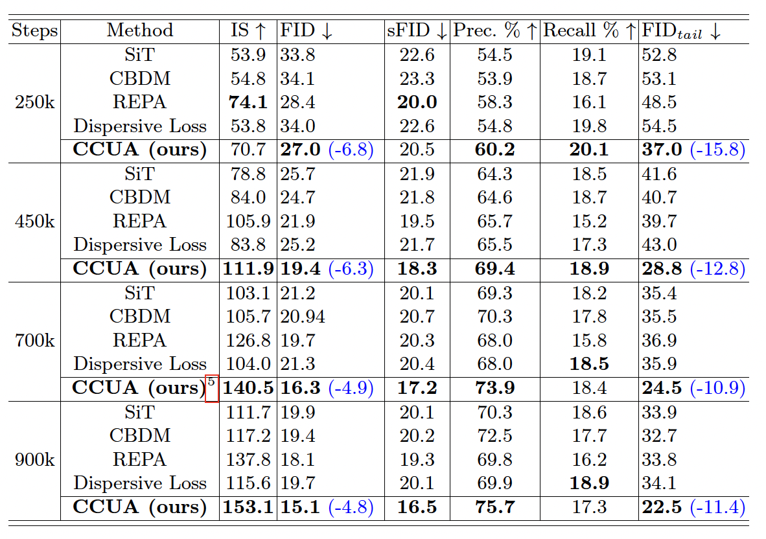
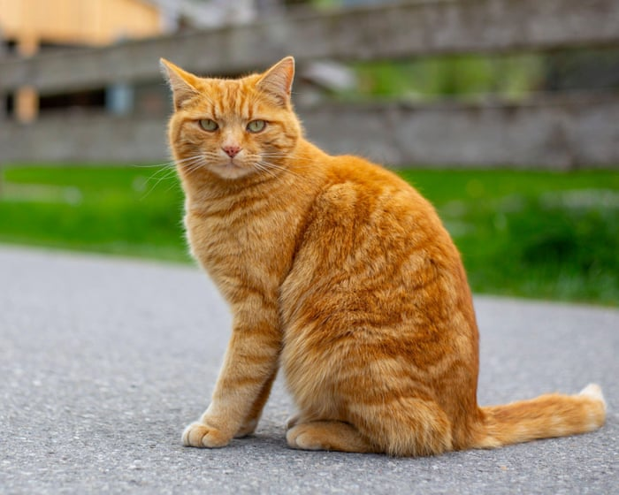



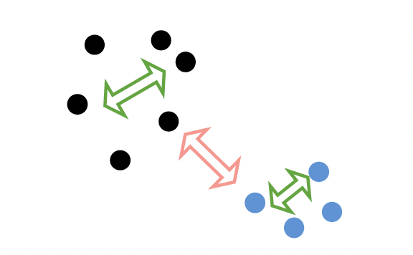
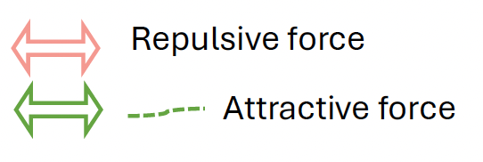
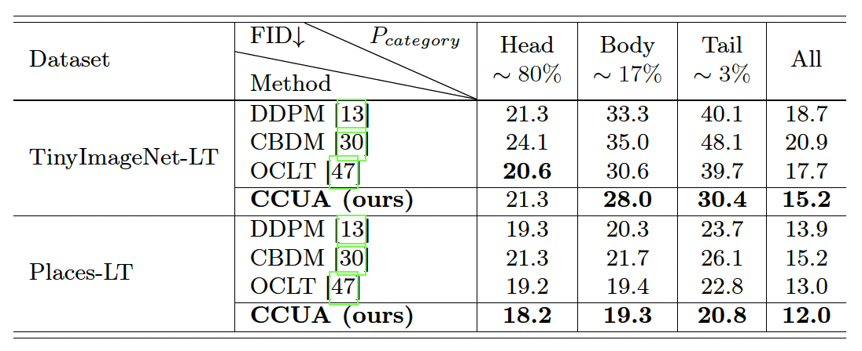
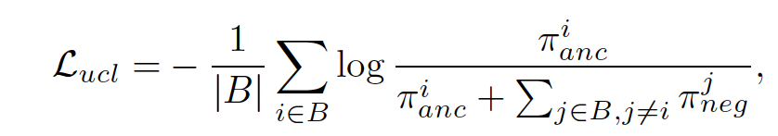
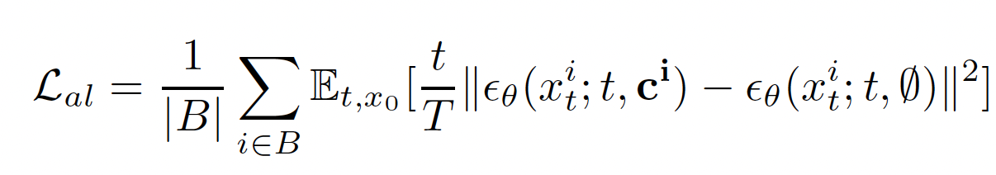
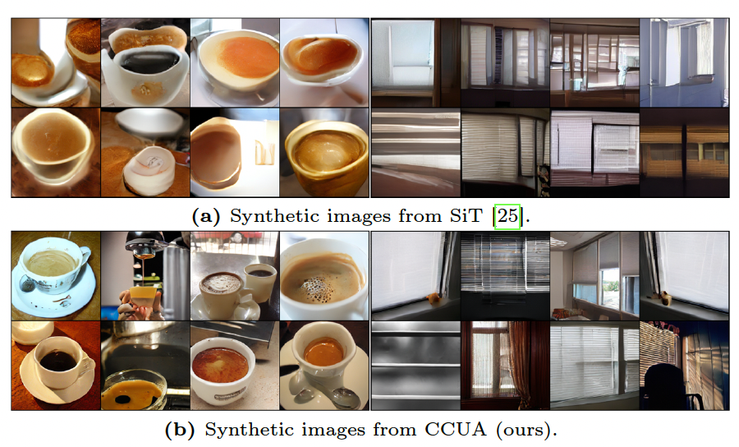
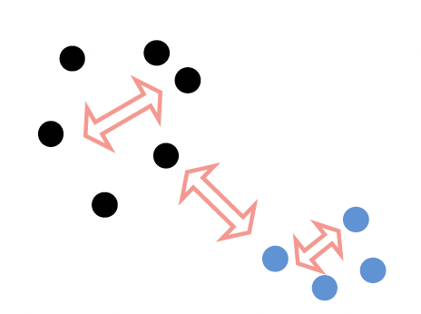
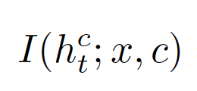
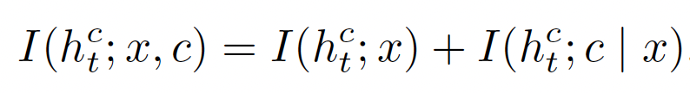
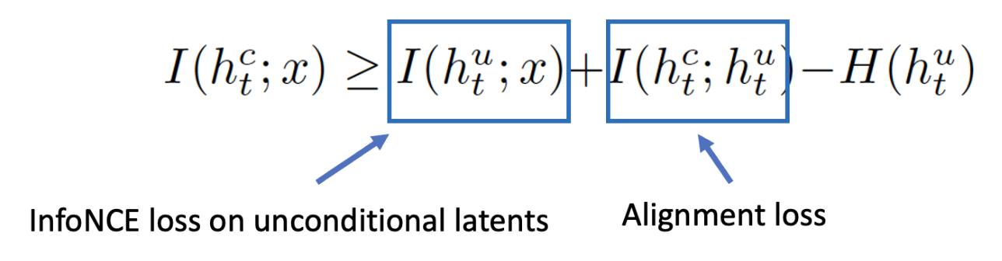
Contrastive Conditional–Unconditional Alignment for
Long-tailed Diffusion Model
Fang Chen¹
Alex Villa¹
Gongbo Liang²
Fuxin Li³
Xiaoyi Lu⁴
Meng Tang¹
¹UC Merced
²TAMU-San Antonio
³Oregon State University
⁴University of Florida
Introduction and Motivation
Our Method: Contrastive Conditional-Unconditional Alignment (CCUA)
Experiments
Training class-conditional diffusion
models with long-tailed data.
How to improve quality for tail class?
A Simple baseline: Batch Resampling
Resampled data:
Problem: Overfitting/Mode Collapse
Our method: “make” latents diverse
Key synergetic ideas:
  Diversify unconditional generation
  Align conditional generation with unconditional generation
Consider both conditional latents and unconditional latents
We propose two simple regularization losses for the two ideas
We improved the diversity and fidelity of tail class for
ImageNet-LT with 256x256 resolution.
Outperform representation learning based methods
including REPA [1] and Dispersive Loss [2]
Our method maintains or even improves head classes
Qualitative results on tail classes:
For a resampled batch B
Contrastive Learning on Latents
Diversify unconditional generation
Align Conditional and Unconditional Gen.
Supervised Contrastive Learning:
Does not increase intra-class diversity
Unsupervised Contrastive Learning
Repulsive force only
Admits a “lazy” solution by
increasing inter-class diversity
InfoNCE loss with negative only
Each pair is a negative pair
Minimizing InfoNCE loss maximizes
mutual information
The same batch goes through network twice
  Unconditional gen.
  Conditional gen.
Loss weighted linearly by timestamp t
Similar to alignment in long-tailed GAN
dog
cat
Theoretical Justification for CCUA
dog
Quantize diversity as mutual information , and decompose as:
Our two losses combined maximizes a lower bound
cat
[1] Yu et.al., Representation alignment for generation: Training diffusion transformers is easier than you think, Arxiv 2024.
[2] Wang et.al., Diffuse and Disperse: Image Generation with Representation Regularization, Arxiv 2026.

