Slide 1
Pseudo-Bound Optimization for Binary Energies
Presenter: Meng Tang
Joint work with
Ismail Ben Ayed
Yuri Boykov

Slide 2
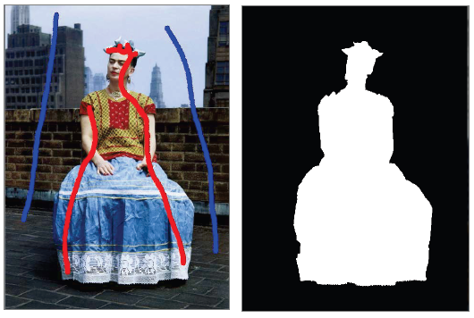
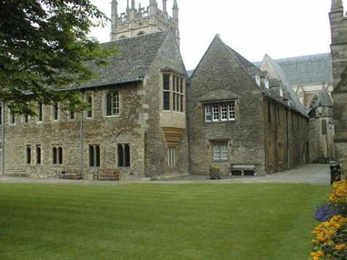
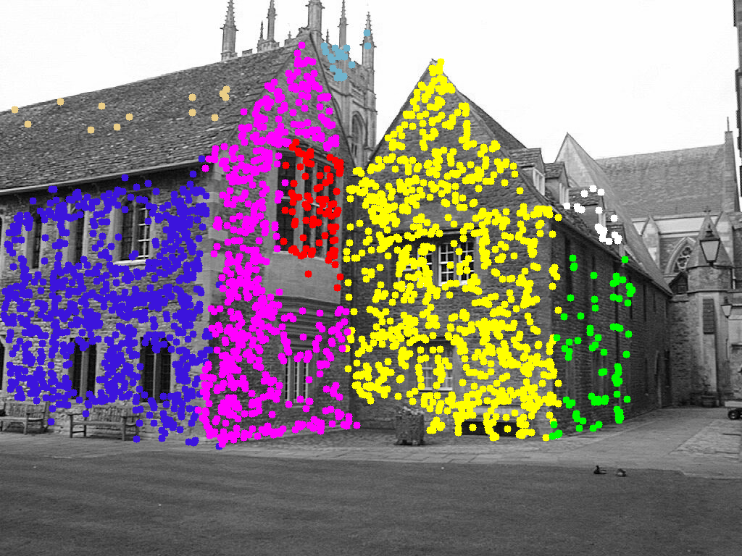
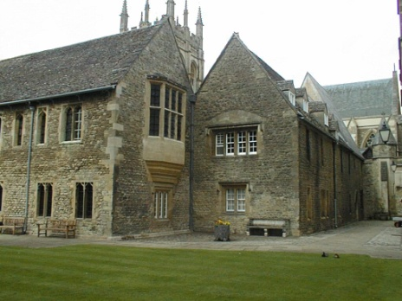
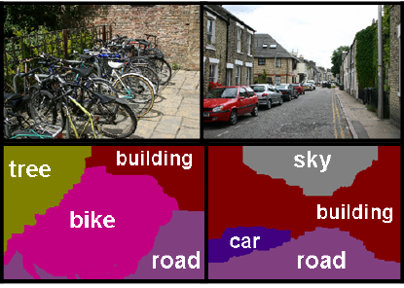
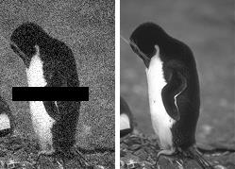
Labeling Problems in Computer Vision
Binary label
Multi-label
Geometric model fitting
foreground selection
Stereo
Semantic segmentation
Denoising inpainting

Slide 3
Energy Minimization for Labeling Problem
S* = arg_{S} min E(S)
s_{p}= 1 (FG) or 0 (BG)
s_{p}= ‘sky’ or ‘road’ or ‘bike’ etc.
foreground selection
Semantic segmentation

Slide 4
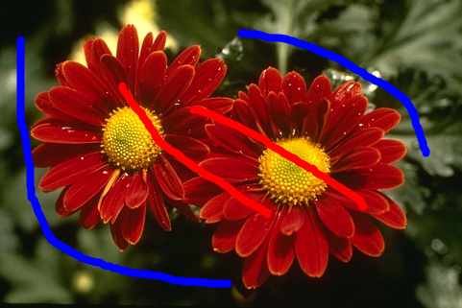
Basic Pairwise Energies
S* = arg_{S} min E(S)
Common in computer vision
Unary term
Pairwise term
Submodular case: fast global solver (Graph Cuts )
e.g. Boros & Hammer. 2002
Example: interactive segmentation
Boykov & Jolly. 2001
Unary term
Pairwise term

Slide 5
More difficult energies
Pairwise nonsubmodular energies
High-order energies
Curvature regularization
Segmentation with repulsion
Binary image deconvolution
e.t.c.
Entropy minimization for image segments
Matching target distribution
Volume constraints
Convex shape prior
Roof duality [Boros & Hammer. 2002]
QPBO-mincut [Kolmogorov, Rother et al. 2007]
TRWS, SRMP [Kolmogorov et al. 2006, 2014]
Parallel ICM [Leordeanu et al. 2009]
…………….
Region Competition[Zhu, Lee & Yuille. 1995]
GrabCut [Rother et al. 2004] [Vicente et al. 2009]
[Gould et al. 2011, 2012][Kohli et al. 2007, 2009]
[Ayed et al. 2010, 2013][Gorelick et al. 2013, 2014]
……………..

Slide 6
Our framework (Pseudo-Bound Opt.)
Pairwise nonsubmodular energies
High-order energies
Curvature regularization
Segmentation with repulsion
Binary image deconvolution
e.t.c.
Entropy minimization for image segments
Matching target distribution
Volume constraints
Convex shape prior
Roof duality [Boros & Hammer. 2002]
QPBO-mincut [Kolmogorov, Rother et al. 2007]
TRWS, SRMP [Kolmogorov et al. 2006, 2014]
Parallel ICM [Leordeanu et al. 2009]
…………….
Region Competition[Zhu, Lee & Yuille. 1995]
GrabCut [Rother et al. 2004] [Vicente et al. 2009]
[Gould et al. 2011, 2012][Kohli et al. 2007, 2009]
[Ayed et al. 2010, 2013][Gorelick et al. 2013, 2014]
……………..

Slide 7
Example of high-order energy
With known appearance models θ₀,θ₁.
Boykov & Jolly. 2001
fixed
Appearance models can be optimized
GrabCut [Rother et al. 2004]
variables
Notes:
Transition: model-fitting, high-order energy

Slide 8
From model fitting to entropy optimization:
[Delong et al, IJCV 2012] [Tang et al. ICCV 2013]
mixed optimization
cross-entropy
entropy
Note: H(P|Q) ≥ H(P) for any two distributions
entropy of
intensities in
entropy of
intensities in
binary optimization
high-order energy
common energy for categorical clustering, e.g. [Li et al. ICML’04]
Decision Forest Classification, e.g. [Criminisi & Shotton. 2013]

Slide 9
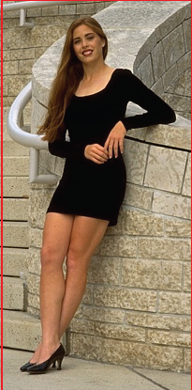
Energy example: color entropy
S
S
S
S
S
S
low entropy
high entropy
S
S
S
S
S
S

Slide 10
Pseudo-bound optimization example:
minimize our entropy-based energy E(S)
Notes:
How to minimize entropy? General framework, entropy is just an example

Slide 11
one standard approach: Block-Coordinate Descent (BCD)
GrabCut [Rother et al. 2004]
≥
mixed var. energy
our entropy energy
BCD could be seen as
bound optimization
for entropy

Slide 12
one standard approach: Block-Coordinate Descent (BCD)
GrabCut [Rother et al. 2004]
≥
mixed var. energy
our entropy energy
^{t t}
E(S|θ₀ ,θ₁ )
E(S)
^{t+1 t+1}
E(S|θ₀ ,θ₁ )
E(S_{t})
E(S_{t+1})
BCD could be seen as
bound optimization
for entropy
S_{t}
S_{t+1}

Slide 13
Bound optimization, in general
(Majorize-Minimize, Auxiliary Function, Surrogate Function)
A_{t}(S)
E(S)
A_{t+1}(S)
E(S_{t})
E(S_{t+1})
Converges to
a local minimum
S_{t}
S_{t+1}

Slide 14
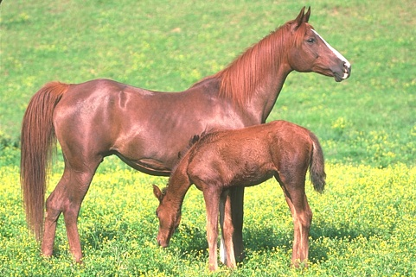
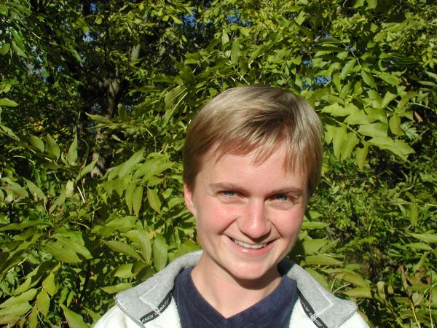
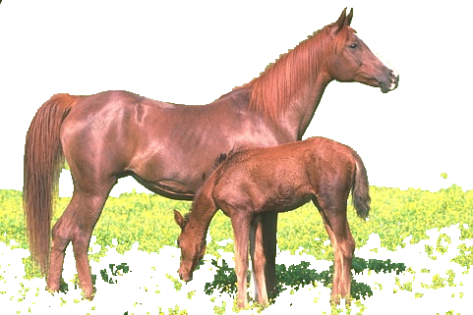
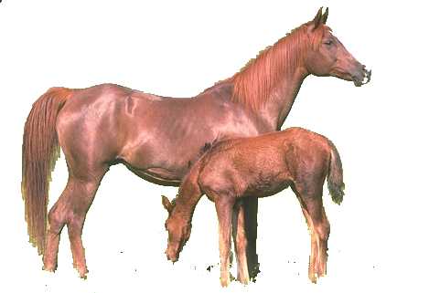
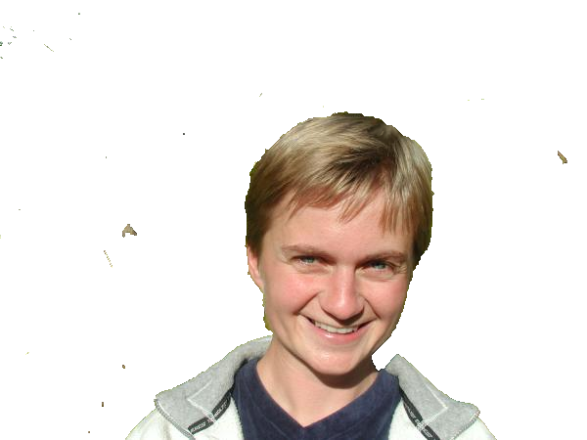
Local minima examples (for GrabCut)
E=1.410×10⁶
E=1.39×10⁶
E=2.41×10⁶
E=2.37×10⁶

Slide 15
This work: Pseudo-Bound Optimization
General framework for energy-minimization
(a)
A_{t}(S)
E(S)
(b)
E(S_{t})
(c)
E(S_{t+1})
Make larger move!
solution space
S_{t}
S
S_{t+1}
Notes:
In this work, we invented pseudo-bound optimization framework. At each step, instead of minimizing a particular bound, we propose to minimize a family of pseudo-bounds. At least one member function in the family is a proper bound. Other member functions may not necessarily bound the original energy across the entire solution space. For example, a, b, c denoted by purple curves here. We call these functions pseudo bounds. Pseudo-bounds may better approximate original energy. The optima of pseudo-bounds may also decrease original energy and may be even better than that of the bound. So those pseudo-bounds also worth being optimized. As long as we can efficiently optimize the family of pseudo-bounds, we can update current solution to one of the candidate solutions with minimum original energy. Compared to standard bound optimization, our pseudo-bound optimization makes larger move at each step.

Slide 16
General form of Pseudo-Bounds
Bound
Bounding relaxation
A_{t}(S)
Ƒ_{t}(S , λ) = + λ R_{t}(S)
Iterate
a cut
Pairwise Submodular
Unary
t
n-links
t-link
S^{λ} = min_{s} Ƒ_{t}(S , λ)
edge capacities depend linearly on λ.
Parametric Maxflow
t-link
Gallo et al. 1989
Parametric Max-flow
S_{t+1} = argminS^{λ} E(S^{λ})
Hochbaum et al. 2010
s
Update
Kolmogorov et al. 2007
Parametric
Pseudo-
Bounds
Cuts
(pPBC)

Slide 17
Specific pseudo-bounds Example 1
A_{t}(S)
Ƒ_{t}(S , λ) = + λ R_{t}(S)
Pairwise Submodular
Unary
How to choose auxiliary and bound relaxation functions?
Ƒ_{t}(S,λ)
=
^{t t}
E(S|θ₀ ,θ₁ )
+ λ(|S|-|S_{t}|)

Slide 18
Specific pseudo-bounds Example 2
A_{t}(S)
Ƒ_{t}(S , λ) = + λ R_{t}(S)
Pairwise Submodular
Unary
How to choose auxiliary and bound relaxation functions?
f(|S|)
High-order example:
Soft volume constriants
|V₀|
|S_{t}|
|S|

Slide 19
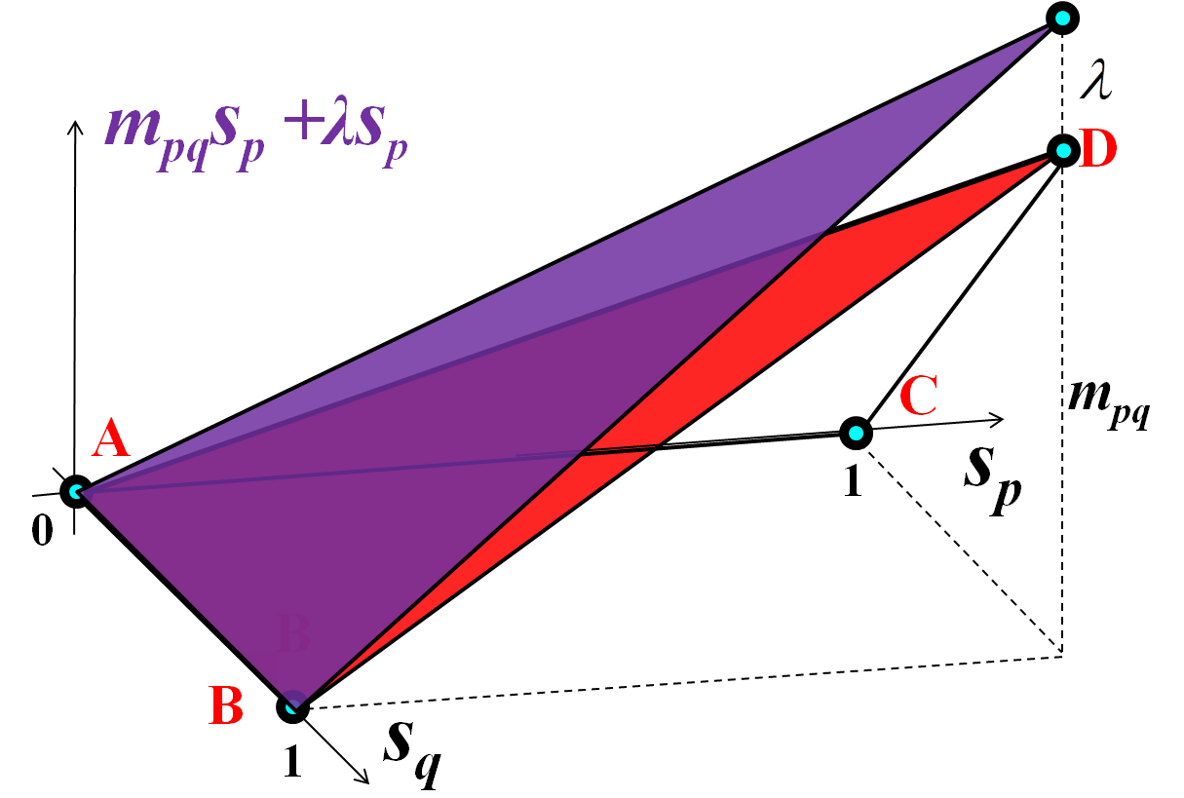
Specific pseudo-bounds Example 3
A_{t}(S)
Ƒ_{t}(S , λ) = + λ R_{t}(S)
Pairwise Submodular
Unary
How to choose auxiliary and bound relaxation functions?
Pairwise example:
Nonsubmodluar pairwise
m_{pq}s_{p}s_{q} , for m_{pq}>0
Gorelick et al. in CVPR 2014

Slide 20
Experimental results

Slide 21
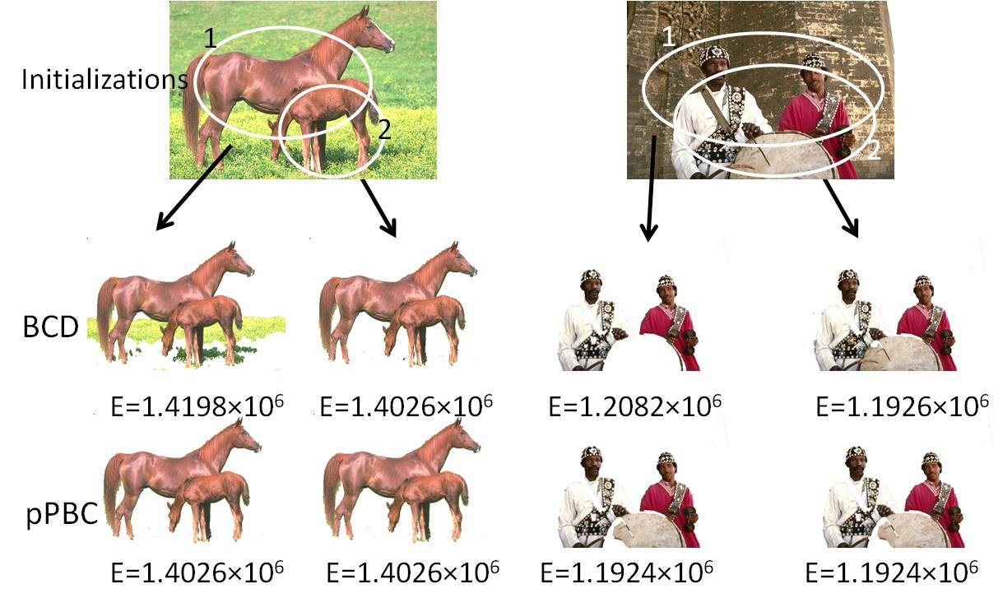
Experiment results (high-order)
Interactive segmentation (entropy minimization)

Slide 22
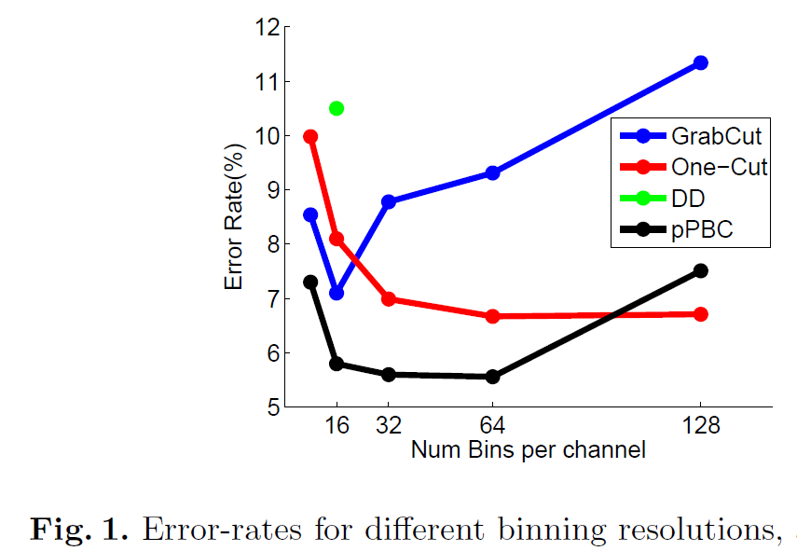
Experiment results (high-order)
Interactive segmentation (GrabCut database)
Rother et al. 2004
Tang et al. 2013
Vicente et al. 2009

Slide 23
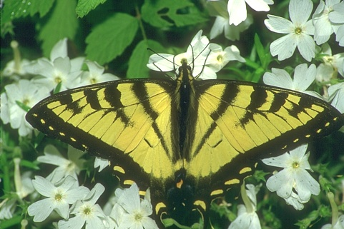
Experiment results (high-order)
Unsupervised binary segmentation
– without prior (bounding box, appearance etc.)

Slide 24
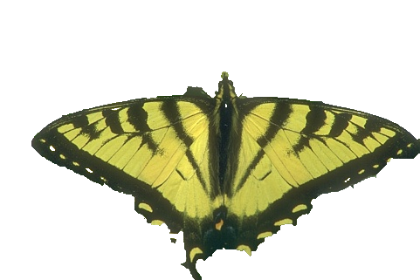
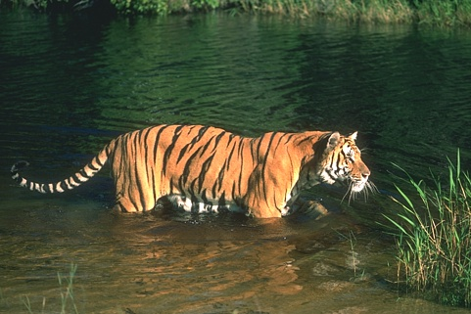
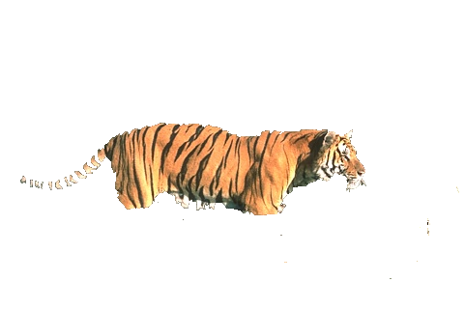
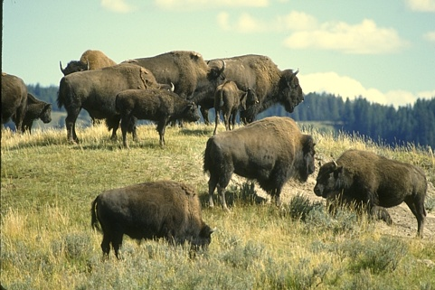
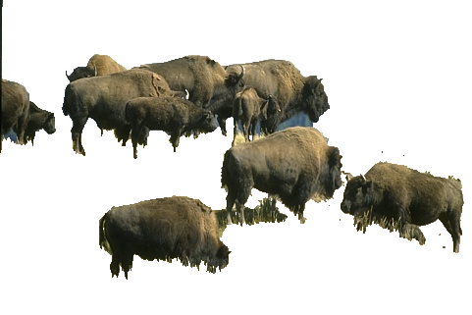
Matching appearance distribution
Input image
Ground truth
Our method

Slide 25
Experiment results (high-order)
Matching color distribution
Ayed et al. 2013
Gorelick et al. 2013

Slide 26
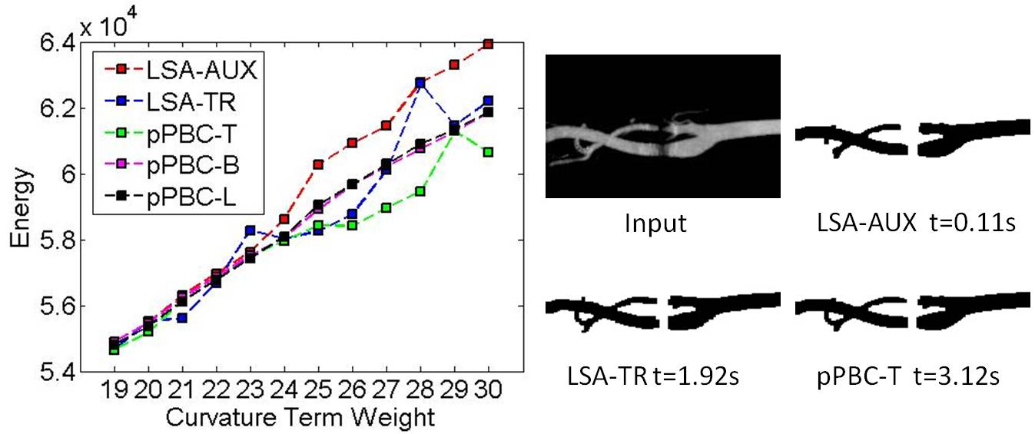
Experiment results (pairwise)
Segmentation with curvature regularization
*
*
*
*
*Submodularization for Binary Pairwise Energies, Gorelick et al. in CVPR 2014

Slide 27
Conclusion
General optimization framework for high- order and pairwise binary energy minimization
Optimize pseudo-bounds efficiently with parametric maxflow
BCD as in GrabCut is a bound optimization
Several options of pseudo-bounds
Achieve state-of-the-art for many binary energy minimization problems
Code available: www.csd.uwo.ca/~mtang73

