Slide 1
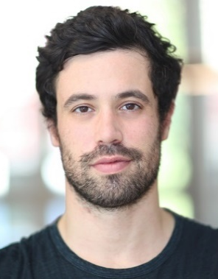
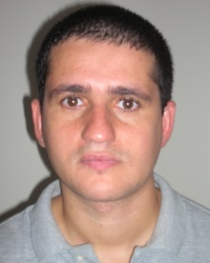
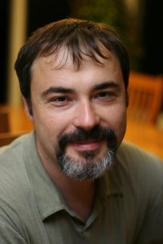
On Regularized Losses for Weakly-supervised CNN Segmentation
Meng Tang
PhD, University of Waterloo
Federico Perazzi
Abdelaziz Djelouah
Ismail Ben Ayed
Christopher Schroers
Yuri Boykov
Adobe
Disney
ETS Montreal
Disney
Waterloo

Slide 2
Convolutional Neural Network for Classification
Architecture of LeNet-5 [LeCun et al. 1998]

Slide 3
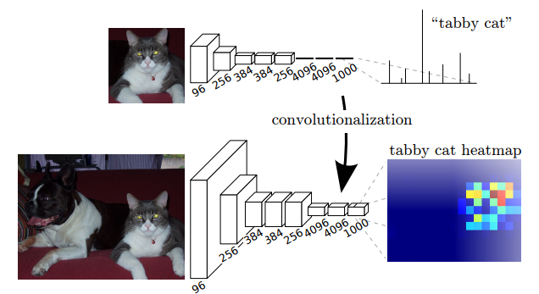
Convolutional Neural Network for Semantic Segmentation
Fully Convolutional Network [Long et al. CVPR 2015]

Slide 4
Losses for CNN Segmentation
Ground truth
Output distribution
cat
0
1
0
…
0.1
0.8
0.05
…
H
dog
sofa
H
…
W
W
pixel-wise Cross Entropy (CE) loss:
- 0 x log 0.1 – 1 x log 0.8 – 0 x log 0.05 …

Slide 5
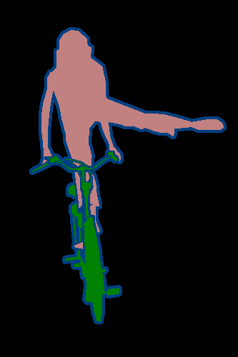
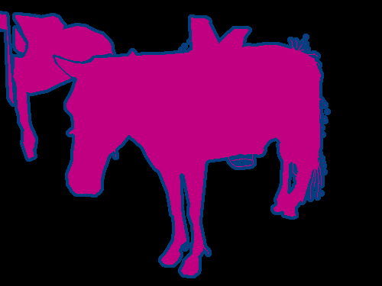
Fully Supervised Segmentation
Fully Convolutional Network [Long et al. CVPR 2015]
segmentation dataset is expensive

Slide 6
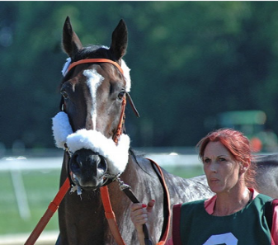
Weakly Supervised Segmentation
bounding boxes
scribbles
points
image-level labels
horse
horse person
person
Slide credit: Chaoyun Wei

Slide 7
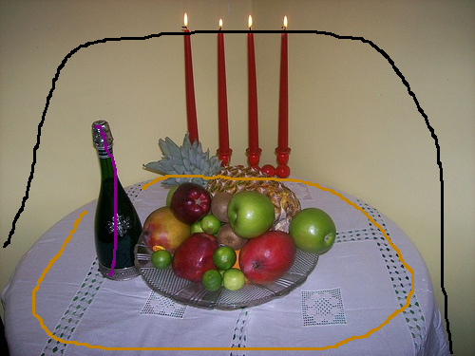
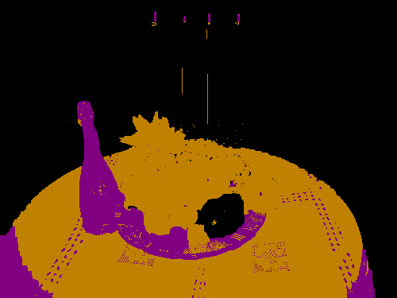
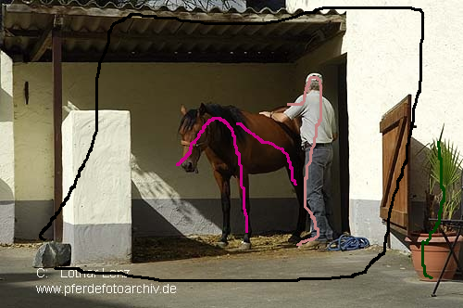
previous work: Proposal Generation
[Dai et al. ICCV 2015]
[Khoreva et al. CVPR 2017]
[Kolesnikov et al. ECCV 2016]
[Lin et al. CVPR 2016]
Scribbles (partial masks)
Proposals (full masks)

Slide 8
Pipeline of previous work
[Dai et al. ICCV 2015]
[Khoreva et al. CVPR 2017]
[Kolesnikov et al. ECCV 2016]
[Lin et al. CVPR 2016]
Interactive
Segmentation
Network
Training
horse
person
proposals

Slide 9
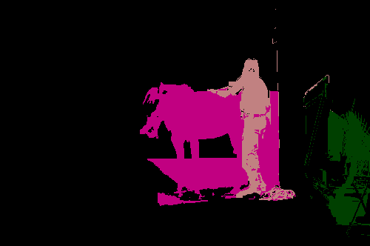
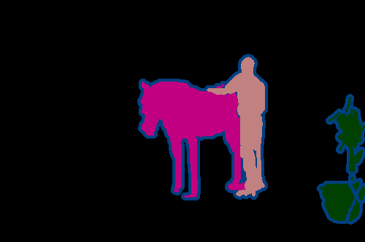
Better proposals ➔ Better CNN trained
input scribbles
by GrabCut
by KernelCut
ground truth
mIOU on train set: 58%
64%
100%
train with such labeling
mIOU on val set: 55%
60%
64%

Slide 10
Limitation: Proposals are full but fake
input scribbles
by GrabCut
by KernelCut
ground truth
mIOU on train set: 58%
64%
100%
train with such labeling
mIOU on val set: 55%
60%
64%

Slide 11
What’s wrong with proposal generation?
Training is sensitive to the quality of proposals
How to obtain good proposals?
Mistakes mislead training to fit errors
A heuristic to mimic “full supervision”

Slide 12
Train without (Full but Fake) Proposals?
Interactive
Segmentation
Network
Training
horse
person
proposals
Can we train directly?

Slide 13
Semi-supervised learning
?
https://www.youtube.com/watch?v=HZQOvm0fkLA&t=264s

Slide 14
Semi-supervised learning
?
https://www.youtube.com/watch?v=HZQOvm0fkLA&t=264s

Slide 15
Semi-supervised learning
Weakly-supervised segmentation
?

Slide 16
Semi-supervised learning

Slide 17
Semi-supervised learning algorithms
[Zhu & Goldberg, “Introduction to semi-supervised learning”, 2009]
[Chapelle, Scholkopf & Zien, “Semi-supervised learning”, 2009]
Self Training
Generative Models
Semi-supervised support vector machines (S3VMs)
Graph-Based Algorithms
Multiview Algorithms

Slide 18
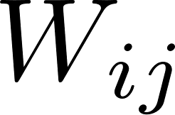
Graph-Based Semi-supervised Learning
i
j
?

Slide 19
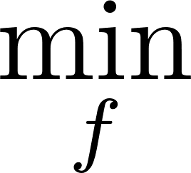
Graph-Based Semi-supervised Learning
empirical risk Loss
for labeled data
regularization Loss
for unlabeled data
Θ: model parameters

Slide 20
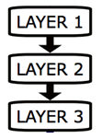
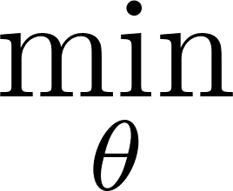
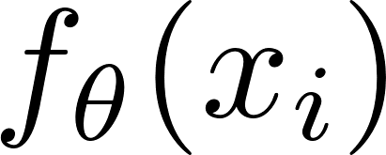
Regularized loss for (deep) semi-supervised learning
Weston, Jason, et al. "Deep learning via semi-supervised embedding." Neural Networks: Tricks of the Trade. Springer Berlin Heidelberg, 2012. 639-655.
input
output
Θ: network parameters

Slide 21
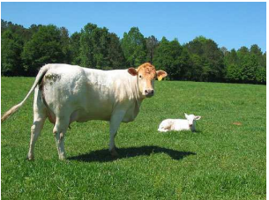
Graph-Based Semi-supervised Learning
Classification ([Weston et al. 2012])
Segmentation (this work)
i
j
j
i

Slide 22
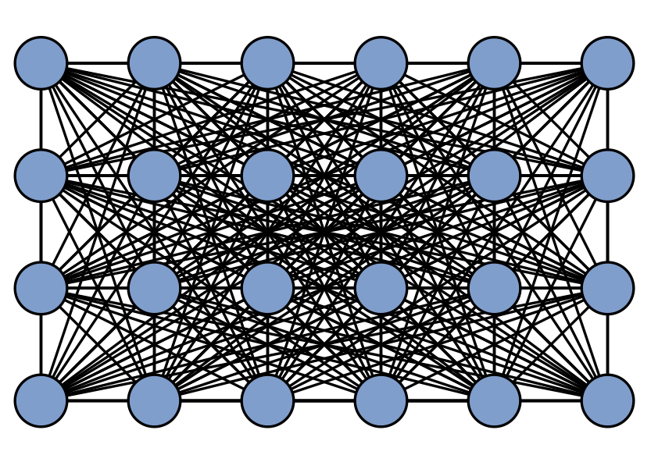
Pairwise MRF/CRF regularization
i
j
Sparse Connected Potts
Fully Connected DenseCRF
[Boykov and Jolly, ICCV 2001]
[Krähenbühl and Vladlen Koltun, NIPS 2011]

Slide 23
Regularized loss for weakly-supervised CNN segmentation
scribbles
unknown pixels
empirical risk Loss
for labeled data
regularization Loss
for unlabeled data
partial Cross Entropy (PCE)
e.g. MRF/CRF, normalized cut, or both

Slide 24
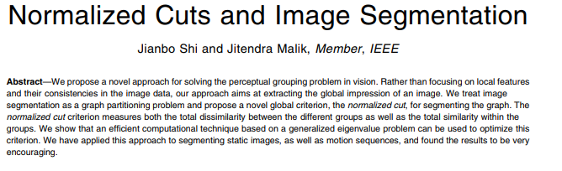
High-order regularization term

Slide 25
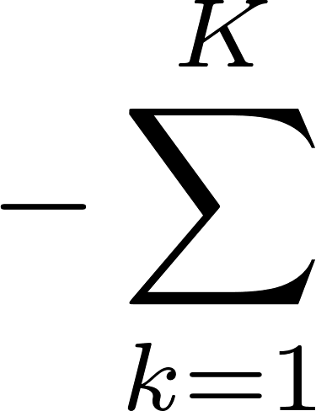
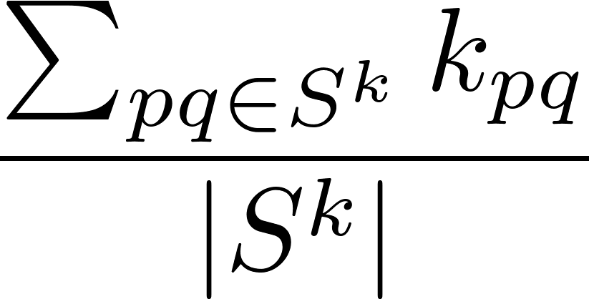
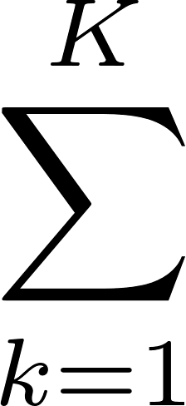
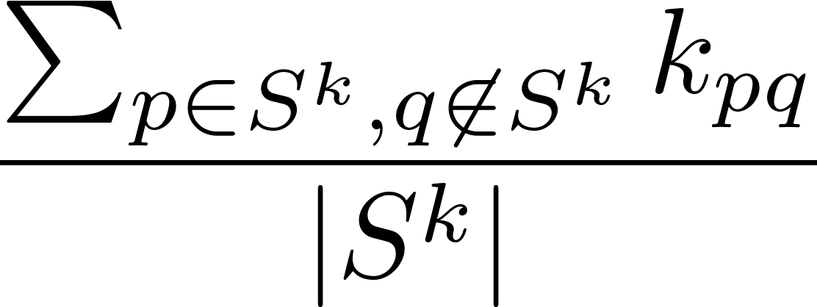
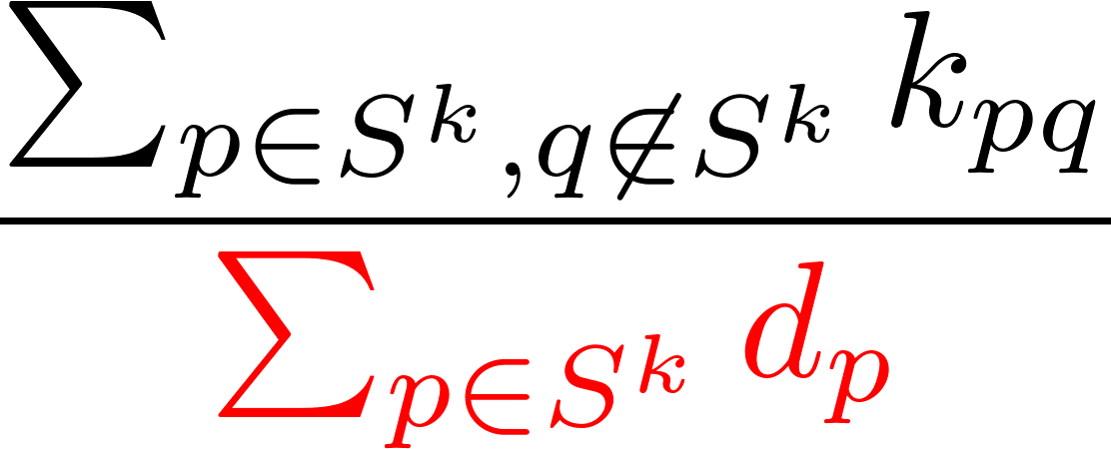
Graph/Kernel Clustering Criteria
Average Association
Average Cut
Normalized Cut
“self-association” for S^{k}
“cut” for S^{k}
“cut” for S^{k}
S¹
S¹
S¹
S³
S³
S³
S²
S²
S²

Slide 26
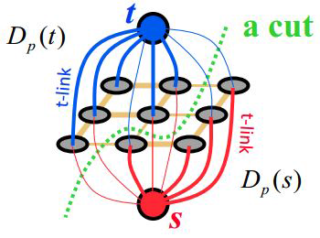
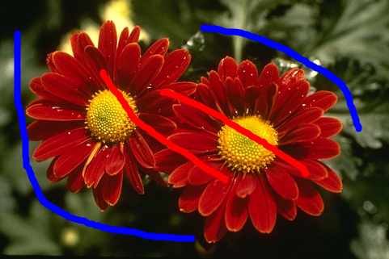
MRF
e.g. CRF as loss
e.g. CRF + NC as losses
Weakly-supervised CNN segmentation
Kernel Clustering
e.g. normalized cut (NC) as loss

Slide 27
On Regularized Losses for CNN Segmentation
Regularization encodes priors and geometric constraints
MRF/CRF regularization, e.g. Potts or DenseCRF
Kernel Clustering Criteria, e.g. Normalized Cut
Convexity, curvature regularization
Volume constraints
Combine Shallow and Deep Segmentation
Simple gradient descent

Slide 28
Experiments
PASCAL VOC 2012 Segmentation Dataset
10K training images (full masks)
1.5K validation images
1.5K test images
ScribbleSup Dataset
scribbles for each object
~3% of pixels labelled

Slide 29
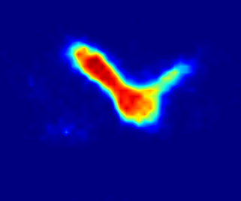
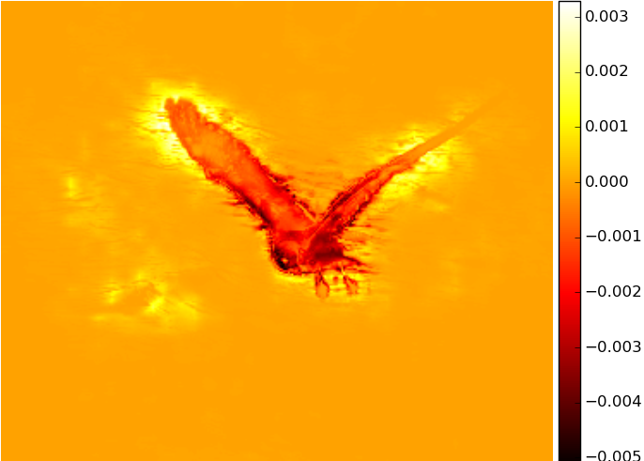
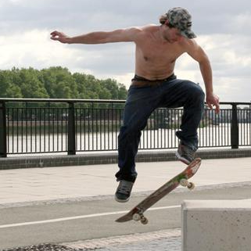
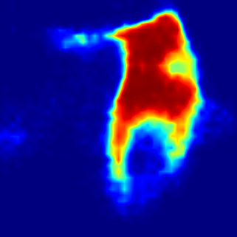
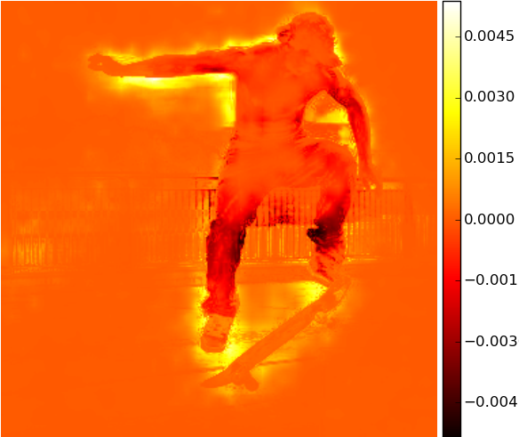
Visualization of Gradients
input

Slide 30
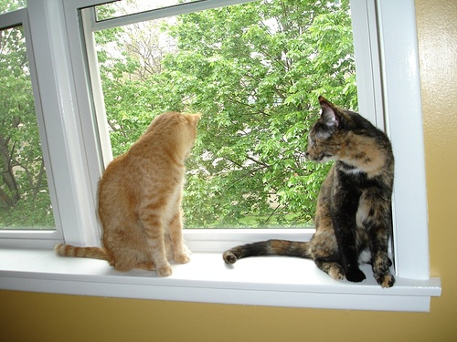
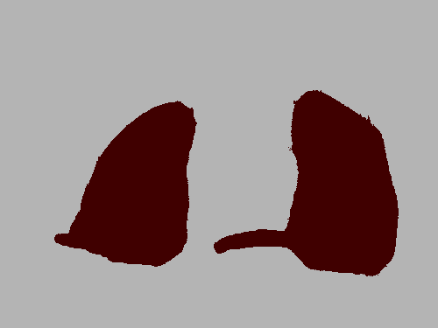
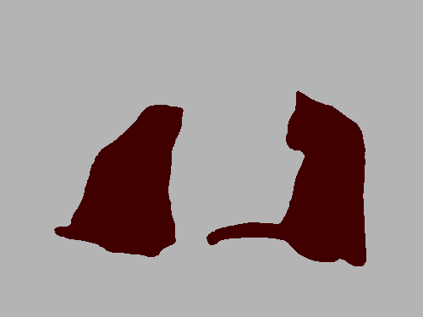
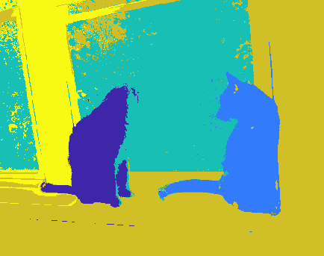
Normalized Cut as Loss for CNN Segmentation
Test image
pCE loss
+ normalized cut loss
“shallow” normalized cut
better color clustering

Slide 31
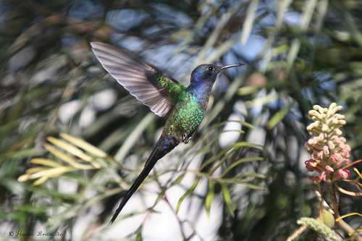
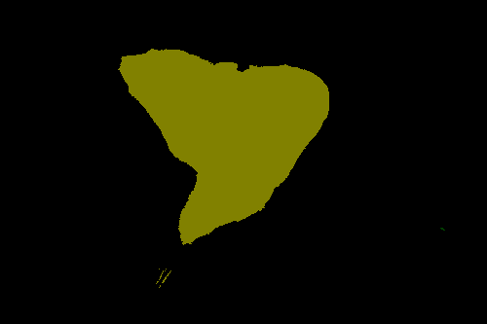
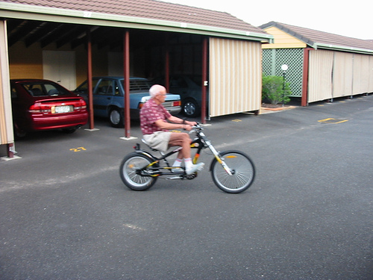
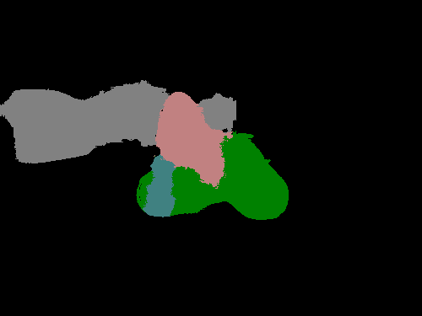
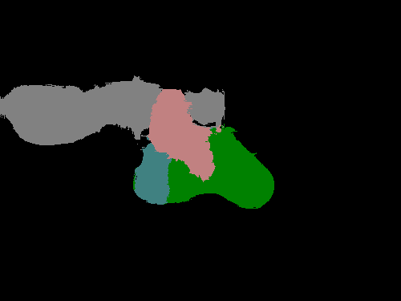
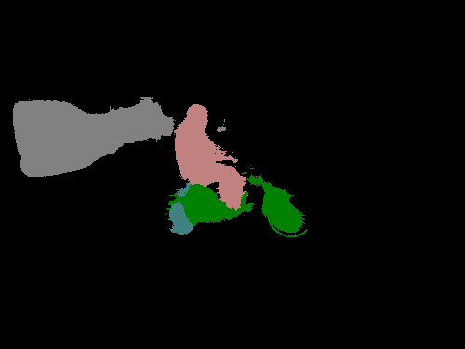
Training with combination of losses
+ normalized cut
+ DenseCRF loss
Test image
pCE loss
+ normalized cut loss
Ground truth
better color clustering
better edge alignment

Slide 32
Compare weak and full supervision

Slide 33
Partial Cross Entropy as Loss Sampling

Slide 34
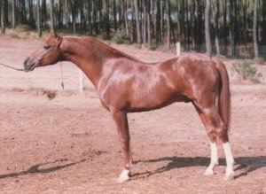
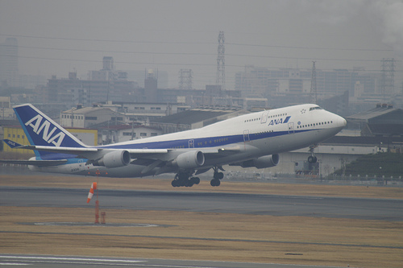
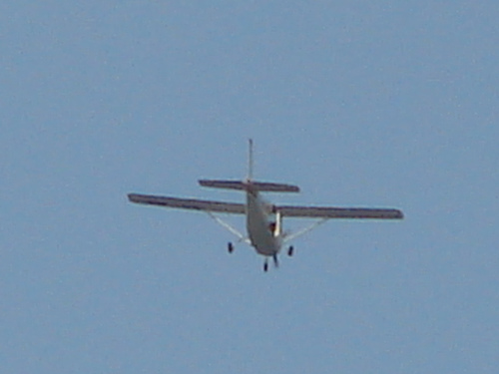
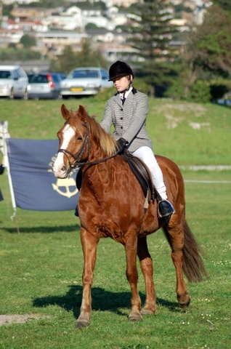
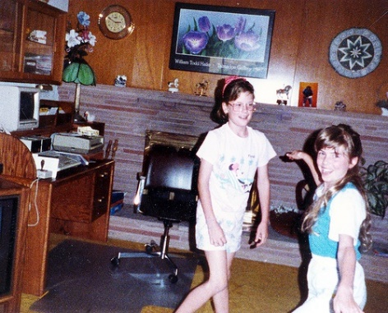
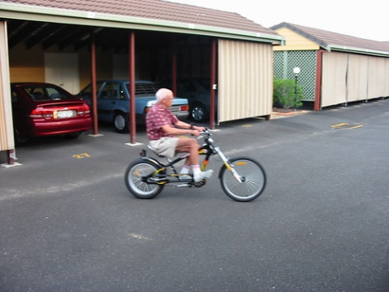
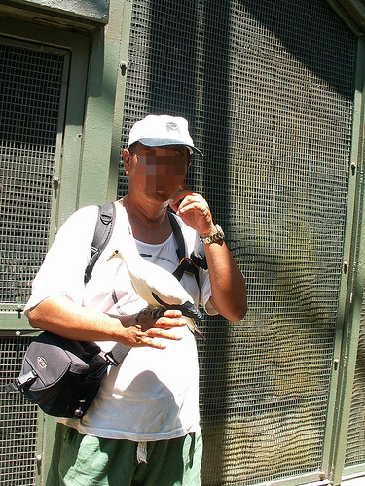
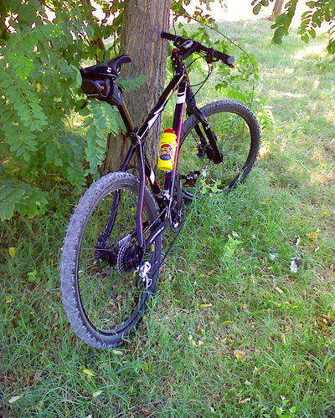
Partial Cross Entropy as Loss Sampling

Slide 35
Partial Cross Entropy as Loss Sampling

Slide 36
Partial Cross Entropy as Loss Sampling

Slide 37
With shorter scribbles
click

Slide 38
Take-home messages
Regularized loss: principled approach in semi-supervised learning
Wealy-supervised CNN Segmentation:
(partical) cross entropy loss
Plus regularization loss (e.g. CRF/MRF and clustering)
No full proposal generation

Slide 39
MRF
CNN segmentation
Kernel Clustering

Slide 40
Future work
Source: GTA5
Target: CityScape
Joint optical flow / segmentation
Video segmentation
Semi-supervised segmentation
Domain adaptation

