Slide 1
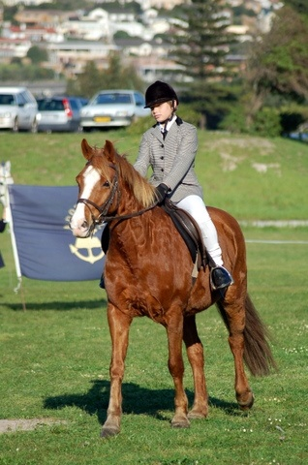
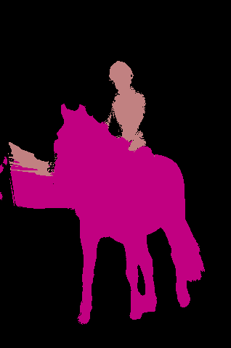
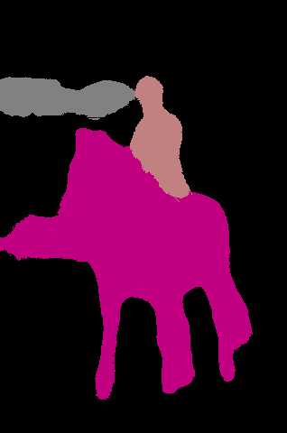
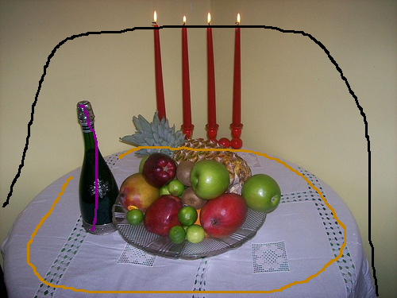
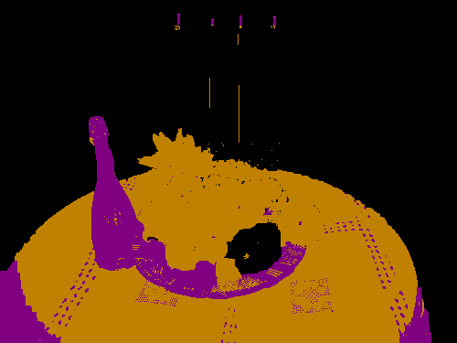
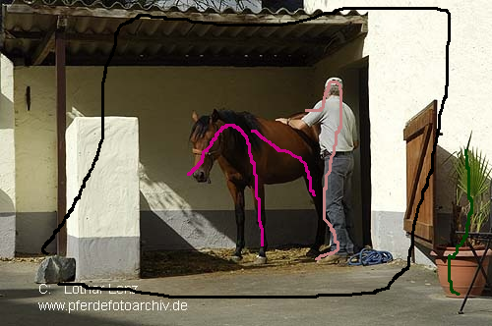
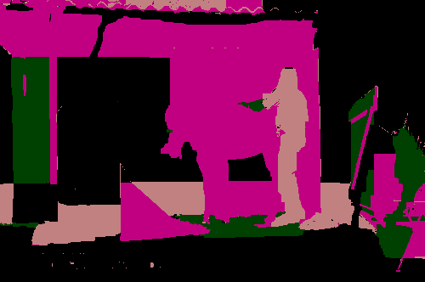
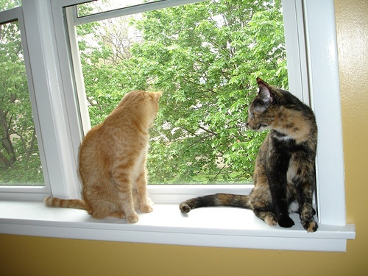
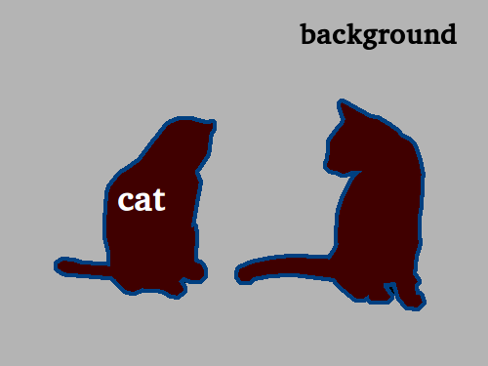
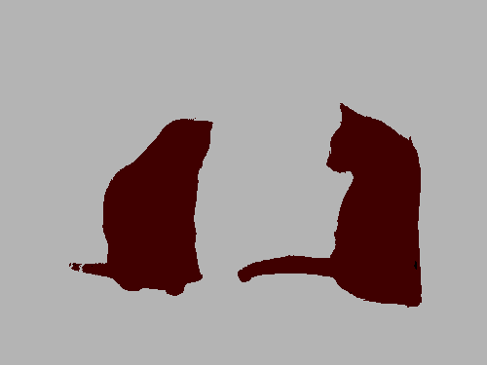
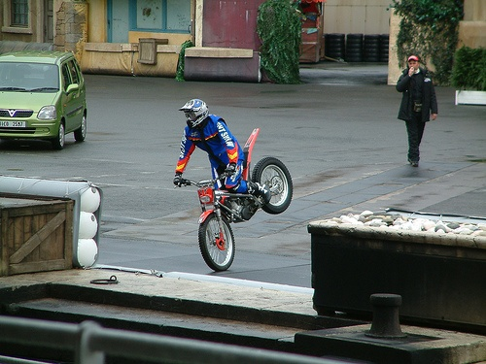
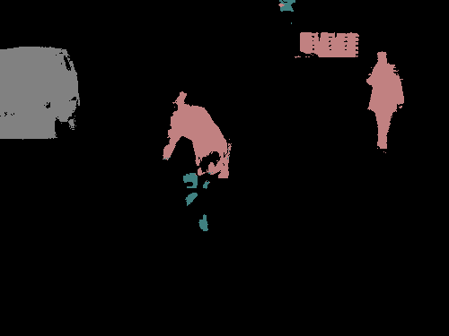
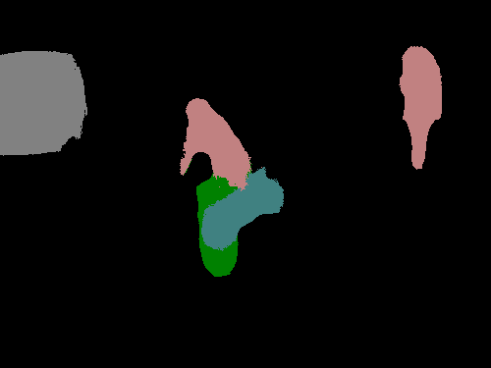
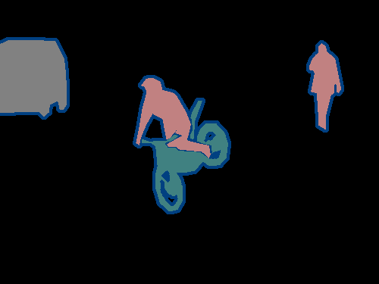
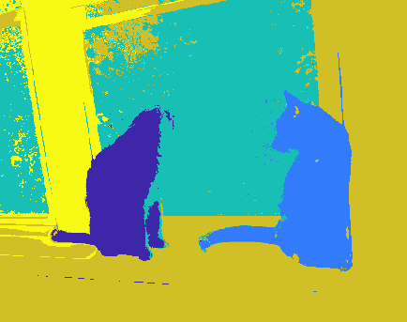
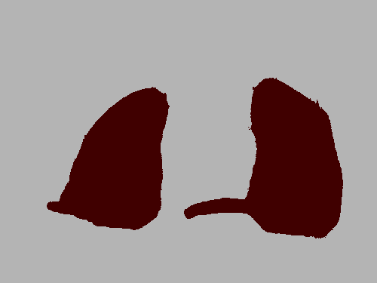
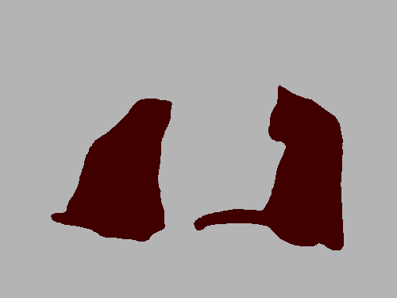
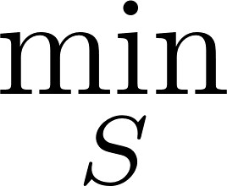
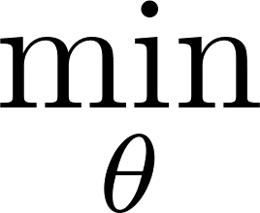
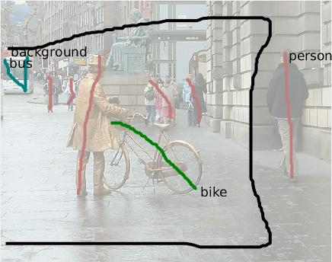
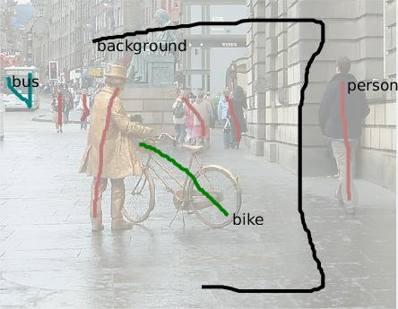
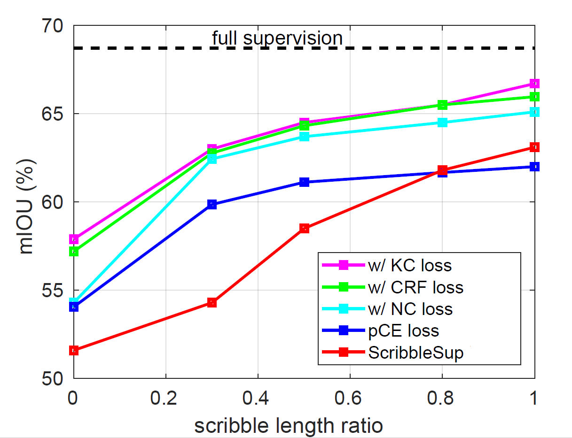
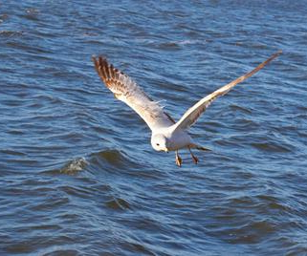
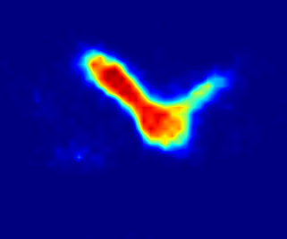
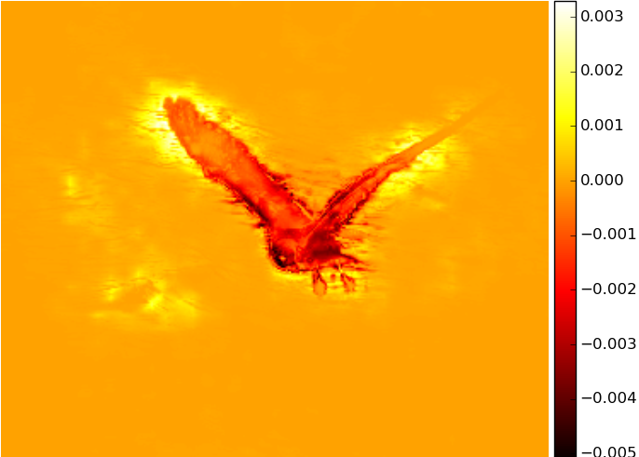
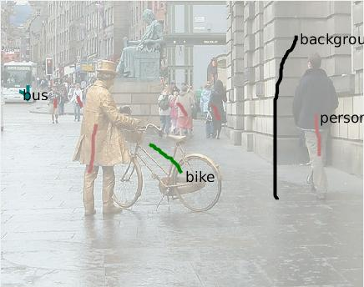
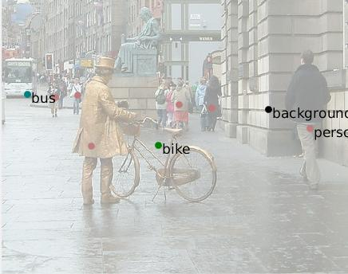
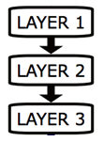
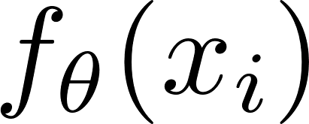
Normalized Cut Loss for Weakly-supervised CNN Segmentation
Meng Tang^{1,2} Abdelaziz Djelouah¹ Federico Perazzi^{1,3} Yuri Boykov² Christopher Schroers¹
¹Disney Research Zurich, Switzerland ²University of Waterloo, Canada ³Adobe Research
Previous work: Proposal Generation
Our methodology: Regularized Loss
E.g. Normalized Cut Regularized Loss
Experiments
Train CNN from full but “fake” proposals:
Joint loss for labeled & unlabeled pixels
(pointwise) Empirical risk loss
(pairwise or high-order) regularization loss
“Shallow” normalized cut segmentation
Pairwise affinity W_{ij} on RGBXY
Balanced color clustering
“Deep” normalized cut loss
Scribbles (partial masks)
Proposals (full masks)
scribbles
unknown pixels
test image
w/ proposals
w/ NC loss
ground truth
[Lin et al. 2016]
test image
ground truth
w/ full masks
mIOU on val set with different networks
Via “shallow” segmentation e.g. graph cut:
data term
regularization term
empirical risk loss
for labeled pixels
regularization loss
for unlabeled pixels
Network | Weak Supervison |  | Full Sup.
 | pCE | pCE + NC
DeepLab-MSc-largeFOV+CRF | 62.0 | 65.1 | 68.7
DeepLab-VGG16 | 60.4 | 62.4 | 68.8
ResNet101 | 69.5 | 72.8 | 75.6
ResNet101+CRF | 72.8 | 74.5 | 76.8
partial Cross Entropy (pCE)
shallow NC
w/ pCE loss only
w/ extra NC loss
Train with shorter scribbles
Gradient of normalized cut
Towards better color clustering
What’s wrong with proposals?
a heuristic to mimic full supervision
mislead training to fit errors
require expensive inference
Examples of regularization:
clustering criteria, e.g. normalized cut (NC)
pairwise CRF
Gradient computation only, no inference
length 1
length 0.5
follow-up
this work
length 0.3
length 0
training image
network output
gradient
click
proposal method
Motivation: Regularized Loss for Semi-supervised Learning
Given M labeled data and U
unlabeled data , learn
Semi-supervised deep learning [Weston et al. 2012]
Partial CE as Loss Sampling
Follow-up Work [Tang et al. arXiv 2018]
input
empirical risk loss
for labeled data
regularization loss
for unlabeled data
Simple but overlooked
Sampling in Stochastic Gradient Descent
scribble as sampling
u_{p}=1 for scribbles, 0 otherwise
Other regularization as losses:
pairwise CRF regularization
normalized Cut plus CRF
Besides weak-supervision
full-supervision (all fully labeled)
semi-supervision (w/ unlabeled images)
?
?
output
labeled data only
labeled & unlabeled data
1. Lin et al. "Scribblesup: Scribble-supervised convolutional networks for semantic segmentation." CVPR 2016.
2. Weston et al. "Deep learning via semi-supervised embedding." Neural Networks: Tricks of the Trade, 2012
3. Tang et al. "On Regularized Losses for Weakly-supervised CNN Segmentation." arXiv 2018.

